Slide 1
Introduction to Identity

Slide 2
What is an identity?
A set of attributes related to an entity (ISO/IEC 24760-1)

Slide 3
entity (n): a thing with distinct and independent existence.
We have lots of different types of entities in the identity space…

Slide 4
Name
Email Address
Gender
Birth Date
Phone Number
Password

Slide 5
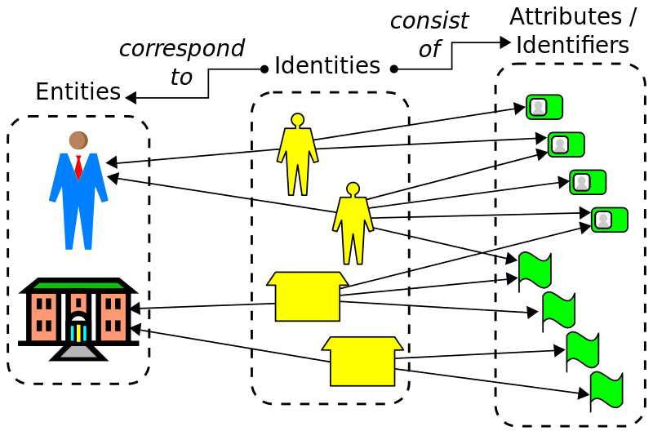
https://en.wikipedia.org/wiki/Identity_management

Slide 6
What makes up your digital identity?
aka what do you already know about your users?

Slide 7
Sources of identity - students
Student number / identifier
Name
Address
Qualifications
Course registration
Marks, exam results
Password
Email address
…

Slide 8
Sources of identity - staff
Employee number / identifier
Name, address, phone number
Contract status
Password
Email address
Faculty, department, division
Committee membership
…

Slide 9
Sources of identity – academic & research
Current research
Grants
Publications, research output?
…

Slide 10
Systems using identity
Where does identity live in your institution?

Slide 11
Registrar
Information
Technology
Library
Human
Resources
Research Office

Slide 12
Systems using identity
User Active Directory
Student records
Human resources/HCM
Payroll
Current research information system (CRIS)
Grant management system
Institutional repositories
Alumni relations
…
Notes:
HCM - Human Capital Management (Employee Management Systems)

Slide 13
Student Records
Active Directory
Institutional Repository
Human Capital Management
CRIS
Payroll

Slide 14
https://en.wikipedia.org/wiki/Identity_management

Slide 15
Identity Management
“enables the right individuals to access the right resources at the right times and for the right reasons” (Wikipedia).
“processes, technologies, and policies employed to manage and control digital identities within an organization or system” (ChatGPT).

Slide 16
https://collaboration.canarie.ca/elgg/file/download/3173
Notes:
Some slides from a presentation by Chris Philips of Canarie/Canadian Access Federation. These are used to facilitate a discussion around where individual attendees are in terms of their own process and maturity.

Slide 18
What is needed to get to this stage?

Slide 19
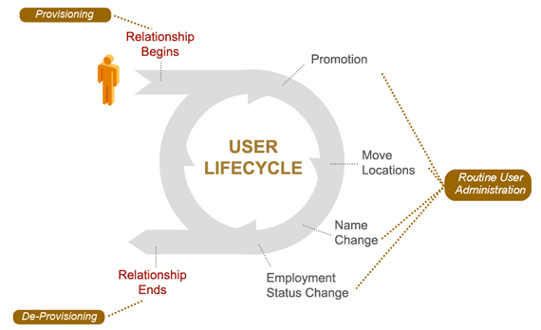
Identity Management Life Cycle
http://www.ithancreek.com/identity_management.asp

Slide 20
Centralising identity – authoritative sources
If you haven’t already done so, conduct an institution-wide audit of identity to determine who has what attributes
Determine the authority for each attribute, e.g:
Email address -> IT department
Student numbers -> Registrar
Student name -> Registrar
Staff name -> Human resources
Determine consumers for each attribute
Determine what constraints exist for each attribute:
Name field is 100 chars at authority, but CRIS system only accepts 80 chars

Slide 21
Centralising identity – interim steps (1)
You probably already have some processes to share information between departments, but:
Make sure these are aligned with the audit results (right authority)
Use common language and descriptions (what do we mean by givenName?)
Start aligning the constraints (if smallest name field is 80 chars and this cannot be changed, use 80 char names)
Introduce update processes to ensure identities remain in sync (all consumers are told when a change happens at the authority)

Slide 22
Centralising identity – interim steps (2)
You need institutional buy-in – can be hard to get
Take small steps, easy wins
but do not lose sight of the big picture
These interim steps do not need to depend on technology

Slide 23
What are the small steps?

Slide 24
Centralising identity – next steps
Consider identity registry / vault systems

