Slide 1
Registries

Slide 2
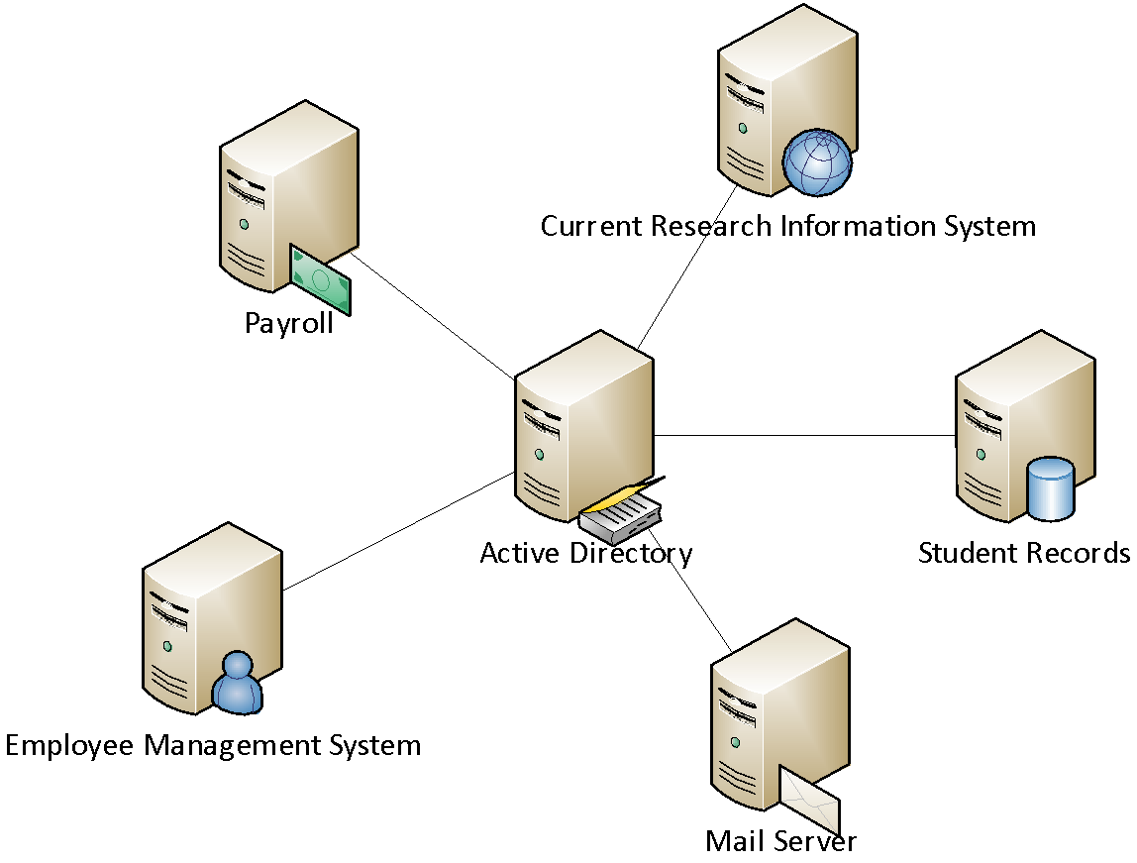
“Lets put everything in AD”

Slide 3
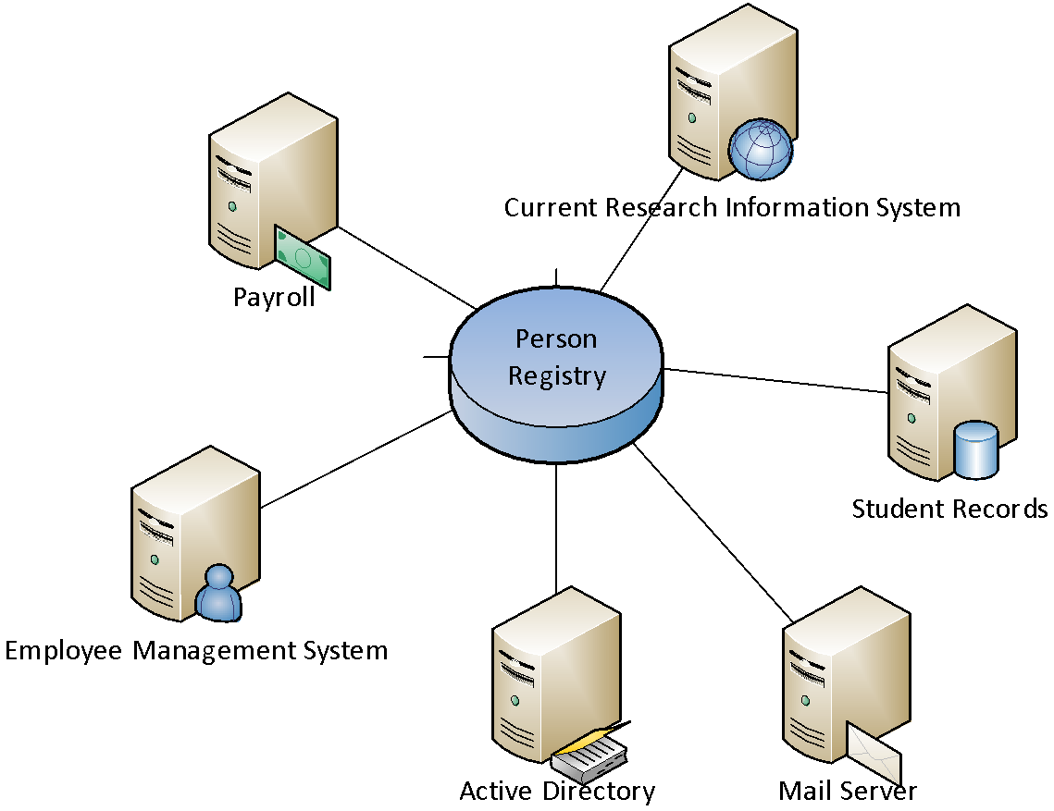
Person Registry
Just another consumer of identity

Slide 4
Person Registry
Remember we spoke about authorities? These feed your registry…
Unique identifier
Name (from HR)
Email address (from IT)
Employee number (from HR)

Slide 5
Person Registry - Software
NetIQ (Novell) Identity Manager
Microsoft Identity Manager (MIM)
IBM Tivoli Identity Manager
Oracle Identity Manager
OpenIAM
Apache Syncope

Slide 6
Person Identifiers

Slide 7
Person Identifiers
What are the privacy implications
Username
National ID
Passport number
Student number
Employee/staff number
Email address?
ORCID iD
Do we agree on formatting?
In what circumstances can they change?
Is there ever duplication?

Slide 8
What makes a good person identifier?
4NF

Slide 9
Identifier concepts/terminology
Persistent vs transient
Transferable / reassignment
Unique
Pseudo-anonymous
Opaque
Pseudonym
Targeted

Slide 10
Privacy-preserving identifiers
Should be generated
not the same as the identifier in your person registry/directory
Must be opaque and uni-directional
e.g. a SHA-256 hash
Think about making them targeted

Slide 11
ORCID iD
Open Researcher and Contributor Identifier
https://orcid.org/0000-0002-8020-0314
Persistent, opaque
Institutionally independent
Like a DOI for people

Slide 12
inetOrgPerson
A person object class / schema for Internet and Intranet directory service deployments.
https://tools.ietf.org/html/rfc2798

Slide 13
inetOrgPerson
Used by default in most directory services (e.g. ActiveDirectory)
givenName
sn
displayName
mail
ou

Slide 14
eduPerson
A person schema for higher education…
https://www.internet2.edu/products-services/trust-identity/eduperson-eduorg/

Slide 15
eduPerson
eduPersonPrincipalName
eduPersonAffiliation
eduPersonScopedAffiliation
eduPersonOrcid
eduPersonEntitlement

Slide 16
eduPerson - scoping
How do you make an identifier globally unique?
We can leverage on DNS
RADIUS does this with realms
guy@staff.tenet.ac.za

Slide 17
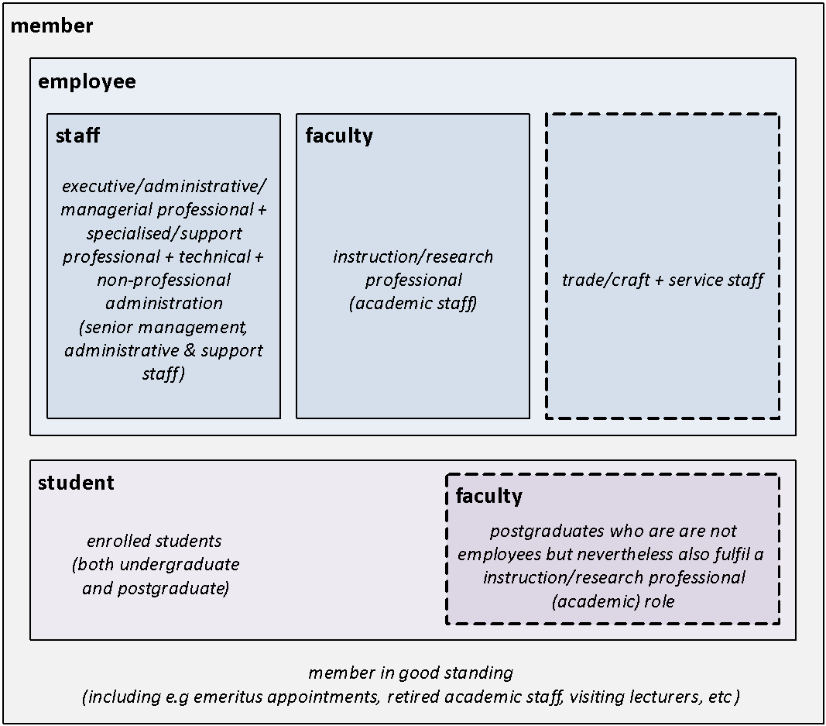
eduPersonAffiliation
Controlled vocabulary:
alum
affiliate
employee
faculty
library-walk-in
member
staff
student
Can have national extensions
https://www.terena.org/activities/refeds/docs/ePSAcomparison_0_13.pdf
https://safire.ac.za/technical/resources/generating-edupersonaffiliation/
Notes:
Specifies the user's relationship(s) to the institution

Slide 18
eduPersonEntitlement
Widely used by library providers
But slowly being superseded by eduPersonScopedAffiliation
urn:mace:dir:entitlement:common-lib-terms

Slide 19
Group Registries

Slide 20
Group Registries
Define the relationships between entities
Can be as simple or complex as you like/need

Slide 21
Access control
Groups (GBAC)
Attributes (ABAC)
Roles (RBAC)

