Slide 1
Silos Exercise

Slide 2
Human Resources
Research Office
Salaries / Payroll
Registrar / Student Records
Library
Information Technology

Slide 3
What are the relationships between the departments?
What information do they hold?
Who is the authoritative source?

Slide 4
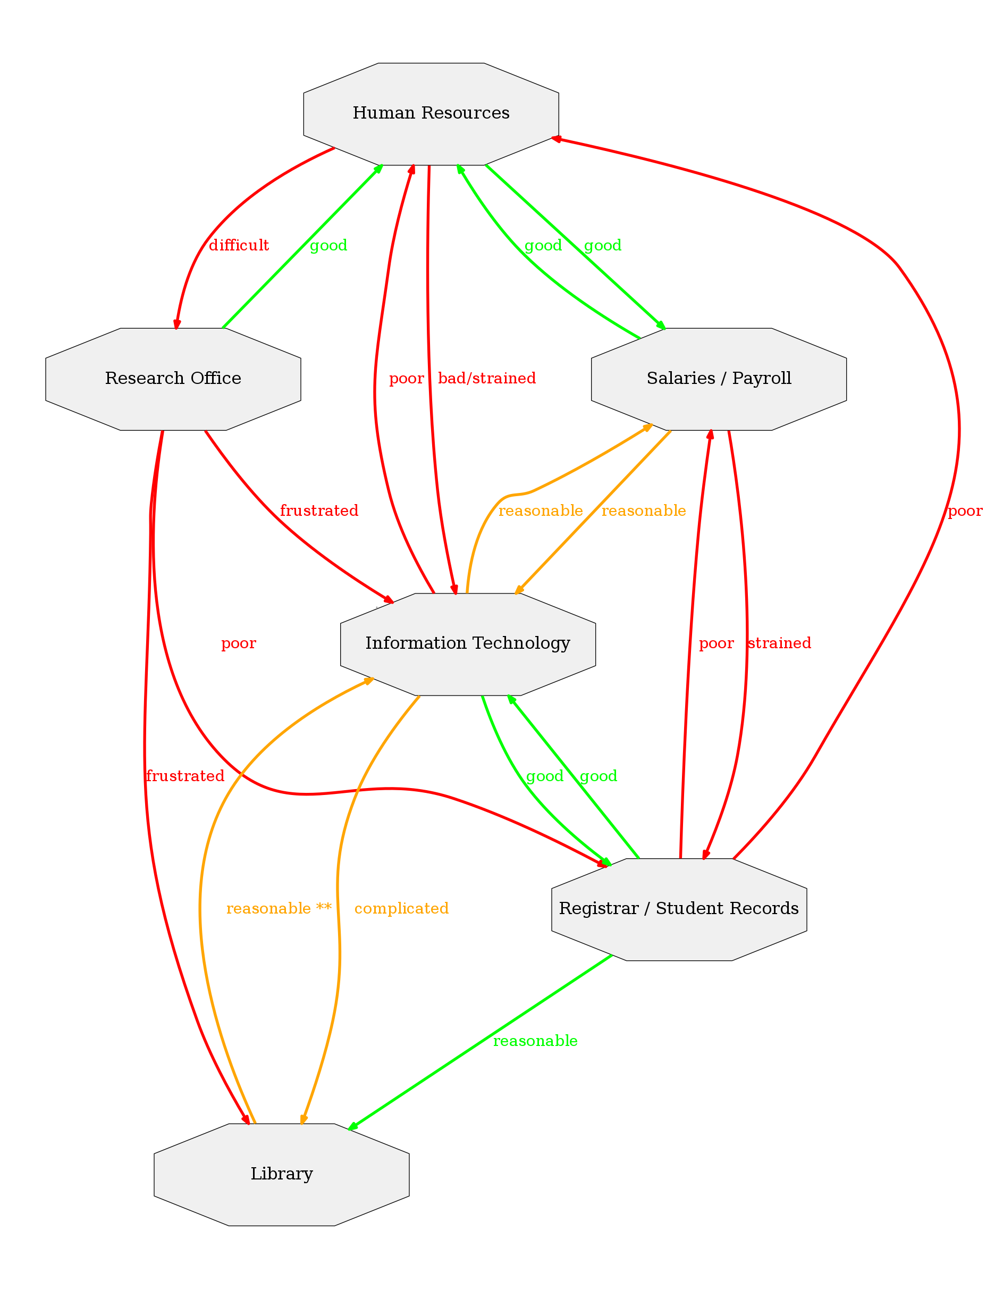

Slide 5
Staff
Date of birth (HR)
Department (HR) -> Library, Research, IT
Email address (IT) -> HR, Salaries, Library, Research
Employee number (Salaries) -> HR, Library, Research, IT
End date (HR) -> Salaries
Given names (HR) -> Salaries, Research, IT
Grants (Research)
Home address (HR)
Income tax number (HR)
Job title (HR)
Marital Status (HR)
Mobile phone number (HR)
ORCID iD (Library) -> Research
Preferred name (IT?) -> Library
Publications (Library) -> Research
Start date (HR) -> Salaries
Surname (HR) -> Salaries, Library, Research, IT
Username (IT)

Slide 6
Students
Courses (Registrar) -> Library, IT, Research
Date of birth (Registrar)
Degree (Registrar)
Email address (IT) -> Registrar, Salaries, Library, Research
End date (Registrar) -> Salaries
Given names (Registrar) -> Salaries, Research, IT
Home address (Registrar)
Marital status (Registrar)
Mobile phone number (Registrar)
ORCID iD (Library) -> Research
Preferred name (Registrar) -> Library, IT
Publications (Library) -> Research
Start date (Registrar) -> Salaries
Student number (Registrar) -> Salaries, Library, Research, IT
Surname (Registrar) -> Salaries, Research, IT, Library
Username (IT)

