Slide 1
Identity Federations
High Level Concepts

Slide 2
In the beginning...

Slide 3
Traditional Identity Management

Slide 4
Traditional Identity Management

Slide 5
Traditional Identity Management

Slide 6
Traditional Identity Management

Slide 7
Traditional Identity Management
Each organization must provision identity
High overhead for some organizations
Research organizations for example may just want to provide services

Slide 8
Traditional Identity Management
Services only consume identity provisioned by service owner organization
Allows services to make assumptions about user identities and credentials
Assumptions become hardened into service over time
Burdens service owner when external users need access

Slide 9
Traditional Identity Management
Collaboration across organizations demands...
Each organization provisions identities for non-members
Users manage multiple identities, each with a single purpose
Often results in users using same login/password for multiple sites

Slide 10
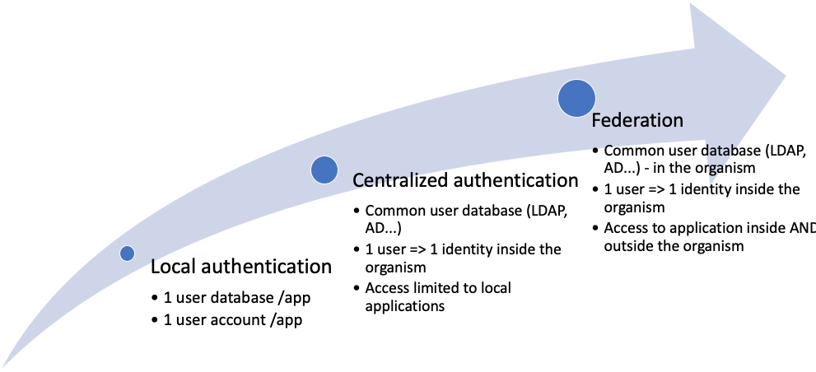
Authentication Management Evolution

Slide 11
Federated Identity Management

Slide 12
Federated Identity Management
Only identity providers provision identities
Not all organizations need to provision identities
Some organizations (campuses) well suited to provision and curate identities
Other organizations (research projects) focus on delivering services

Slide 13
Federated Identity Management
Services consume identities provisioned by other organizations
No longer able to make assumptions about identity and credentials
Initially may take more time to deploy and bring into production
Over time results in more flexible services

Slide 14
Federated Identity Management
Collaboration across organizations is facilitated:
Identity providers focus on provisioning well curated and managed identities
Service providers focus on delivering flexible and useful services
Users manage a single well curated identity

Slide 15
Foundation of Federated Identity is Trust

Slide 16
Foundation of Federated Identity is Trust
Service provider must trust the identity provider to appropriately:
Vet user's real identity at enrollment or registration
Manage credential stores to protect secrets
Assert details about authentication events
Assert user identifiers and attributes (if any)

Slide 17
Foundation of Federated Identity is Trust
Identity provider must trust the service provider to appropriately:
Consume assertions about authentication events
Consume user identifiers and attributes (if any)
Store user identity information
Protect user privacy

Slide 18
Establishing Trust
How do a service provider and an identity provider establish trust?

Slide 19
Bilateral Trust
Identity provider and service provider must agree on
Technical details
Which protocols used to assert and consume identity?

Slide 20
Bilateral Trust
Identity provider and service provider must agree on
Policy
Which users? How are they vetted? What identity details will be asserted? Which will be consumed? How will it be stored? Who will have access to it? Will it be deleted? When?

Slide 21
Bilateral Trust Does Not Scale

Slide 22
Establishing Trust
What if a group of identity providers and service providers came together and established a common set of policies and baselines for technical interoperability to scale trust and facilitate collaboration?
What would we call such a group?

Slide 23
Identity Federation
Identity providers and service providers establishing scalable trust through a common set of policies and technical interoperability baselines.

Slide 24
Commercial Identity Federations

Slide 25
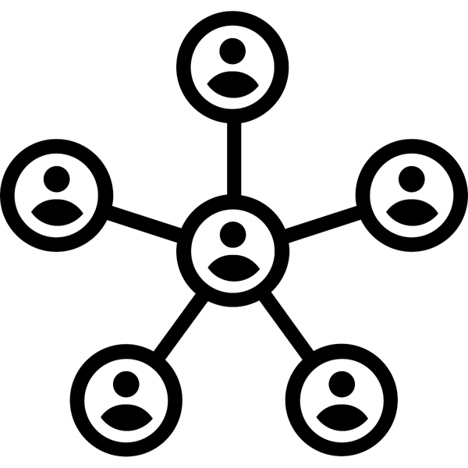
Higher Education & Research Identity Federations
IdP
SP
FedOp
SP
IdP
SP

Slide 26
Higher Education & Research Identity Federations

Slide 27
Higher Education & Research Identity Federations
RENU Identity Federation (RIF)
eduroam (RADIUS/RadSec)
SAML WebSSO

Slide 28
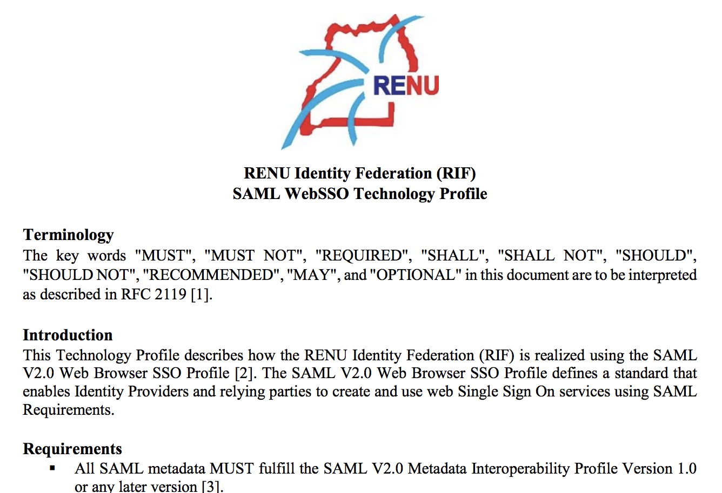
Policies and Technical Interoperability Profile
https://rif.renu.ac.ug/docs/RIF-SAML-WebSSO-Technology-Profile.pdf

Slide 29
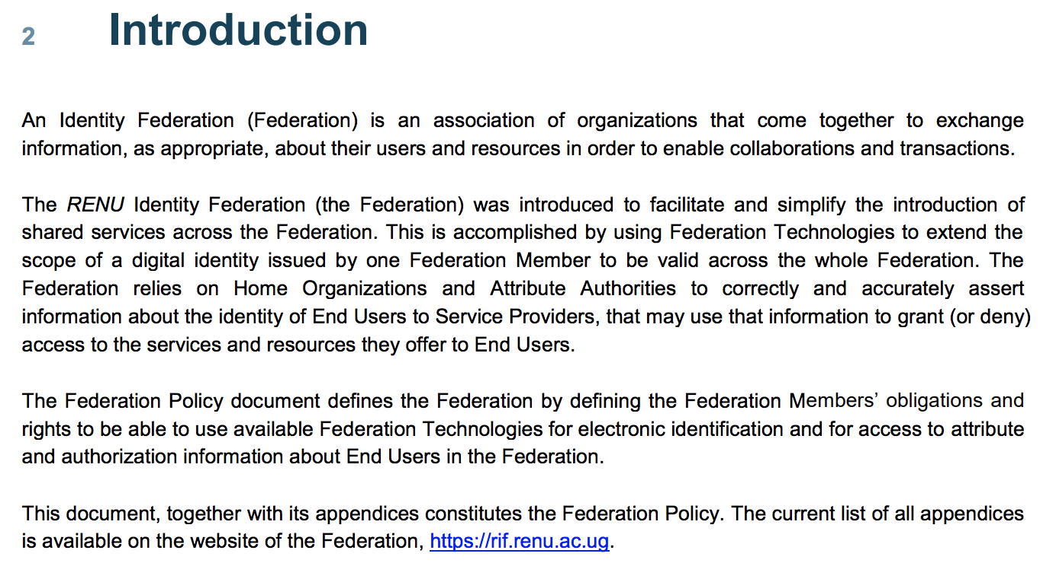
RENU Identity Federation Policy

Slide 30
RENU Identity Federation Membership
RENU Members may join RIF as identity providers (IdPs)
Membership open only to Research and Educational institutions endorsed by the Ministry of Science, Technology and Innovation through the Uganda National Council for Science and Technology (UNCST)

Slide 31
RENU Identity Federation Membership
RENU Members may join RIF as identity providers (IdPs)
Tertiary Education Institutions endorsed by the Ministry of Education through the Uganda National Council of Higher Education (UNCHE).
An Institution that works with research institutions and tertiary education institutions subscribed to RENU membership can be admitted as an affiliate member, through a vote in their favour, by the RENU Board of Directors.

Slide 32
RENU Identity Federation Membership
"However, to join RIF as a Service Provider (SP), an institution, organization, or company DOES NOT have to first subscribe to RENU membership."

Slide 33
Higher Ed & Research Identity Federations

Slide 34
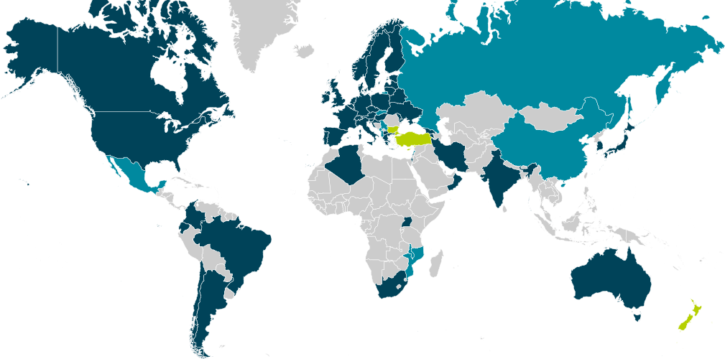
eduGAIN Federation of Federations

Slide 35
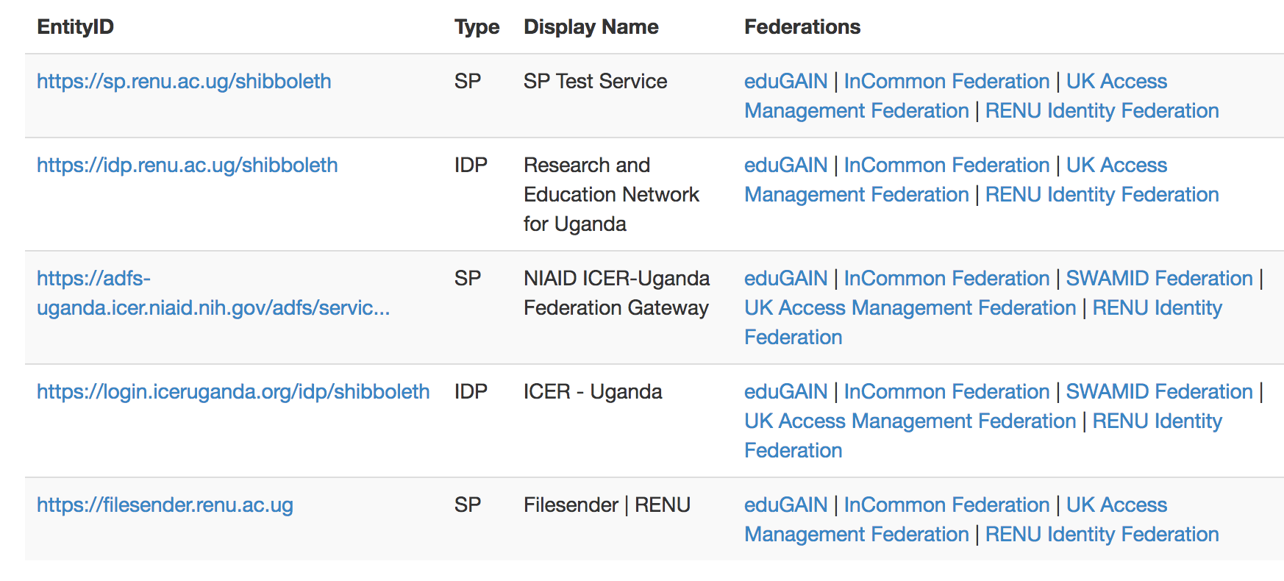
eduGAIN and RENU

Slide 36
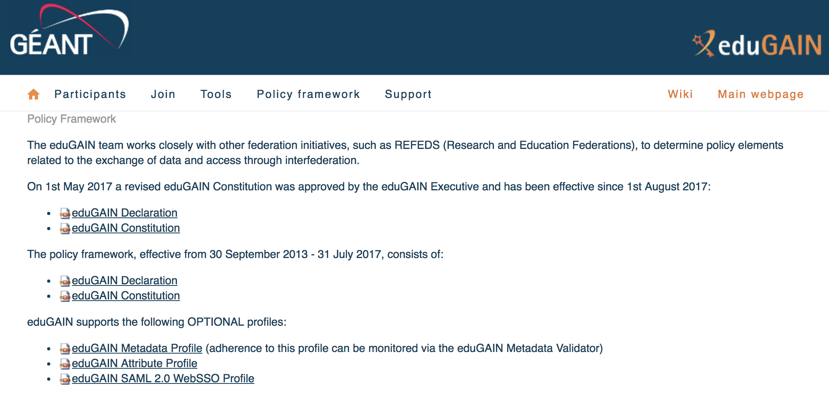

Slide 37
"The mission of REFEDS (the Research and Education FEDerations group) is to be the voice that articulates the mutual needs of research and education identity federations worldwide. The group represents the requirements of research and education in the ever-growing space of access and identity management, working with and influencing the direction of other organisations on behalf of our participants.
REFEDS participants are from a wide range of backgrounds, but all share an interest in developing access and identity management technology, policies and processes. Many participants represent national identity federations and many come from National Research and Education Networks (‘NRENS’)."
https://refeds.org

Slide 38
Foundation of Federated Identity is Trust
As each organization matures its federated identity practice, it is tempting to focus on the minutiae of technical and policy detail and lose site of the big picture: Higher Education and Research federations exist to facilitate and streamline collaboration, research, and scholarship across organizations and are built on a foundation of mutual trust.

