Slide 1
Identity Federations
Introduction

Slide 2
Learning Outcomes
What an Identity Federation is,
What benefits engaging with an Identity federation can bring to your campus and
How you can join an Identity Federation to achieve these benefits

Slide 3
Key Terms
Service Provider (SP) – A online resource that requires federated access.
Identity Provider (IdP) – An organization, such as a university that provides identity accounts for its members or users.
Single Sign-On (SSO) – A method of signing on to an SP using your IdP credentials.
Where Are You From (WAYF) – A web page where users can select their IdPs from a list. After selection, users are typically redirected to their own organizational SSO pages.

Slide 4
Learning Objectives

Slide 5
What Is Identity Federation
“a common framework for trusted shared management of access to on-line resources”
-- InCommon
“… identities from one organisation may use Shibboleth (or another authentication service)” to gain a federated access to service hosted by another organization. Membership of a federation places obligations on members which allow members to trust identity assertions provided by other members
-- JISC

Slide 6
What Is Identity Federation – cont’d
An Identity Federation is a coalition of organisations, called Participants, that share information about their community members according to mutually agreed and usually legally binding policies, processes, and technologies.
The purpose of this information sharing is to enable collaboration among community members and provide access to resources offered by the Participants for the federation’s community members
The Security Assertion Markup Language (SAML) is the basis for the technology standards used by many identity federations to support research and education internationally.

Slide 7
Who benefits? Students and Researchers
Students and Researchers
More collaboration opportunities
Potential access to more resources and data
The Research Community
More efficient utilisation of resources
Easier to share or move data between sites/nodes – where relevant
Authoritative statement of affiliation
Easier research collaboration – can be setup within hours rather than days/weeks

Slide 8
Who benefits? The Campus
The Campus or Institution
Fewer bilateral contracts; more organisations can function under a common framework;
a solidly branded institutional identity which improves the overall reputation of the organization;
a stronger security profile for the network.

Slide 9
Who benefits? The Campus – cont’d
“Identity federation participants could spend time establishing operating principles, technology hooks, and agreed-upon data exchange elements with each partner; or they could do it once through the federation and then leverage these common elements for many relationships ” -- InCommon

Slide 10
Federation Standards
OAuth
open standard for authorisation
E.g : ability to sign in to third-party website after signing in to google once
SAML, Security Assertion Markup Language

Slide 11
Identity Federation Products
Microsoft Active Directory Federation Services (ADFS)
Shibboleth
Open source SSO solution
OpenID
Internet SSO
Authenticate once and you are authorised for multiple websites

Slide 12
Why Federate?
Reduces work
Authentication-related calls to Penn state University’s helpdesk dropped by 85% after implementing a federated approach
Provides current data
User data provided per transaction by the campus is likely to be up-to-date and accurate, as compared to user-centric or service-centric approaches
Insulation from service compromise
Data is pushed to the services as needed. If those services are compromised, the attacker can’t get access to the entire user data store
Minimise attack surface area
Only the IdP needs to be able to contact the user data stores. All effort can be focused on securing this one connection instead of one or more connections per service

Slide 13
Building Blocks of a Federation
Attributes
Identity Provider/Service provider
Discover
Federation Tools
Metadata
Policy

Slide 14
How to join a Federation
Find out if your country has an Identity federation by visiting https://refeds.org
Review the Policy and technical requirements for your home federation. This will typically involve implementing SAML and agreeing to certain policy requirements
Review the services already available via your home federation
if you don't have a home federation, contact REFEDS about other approaches you might be able to take

Slide 15
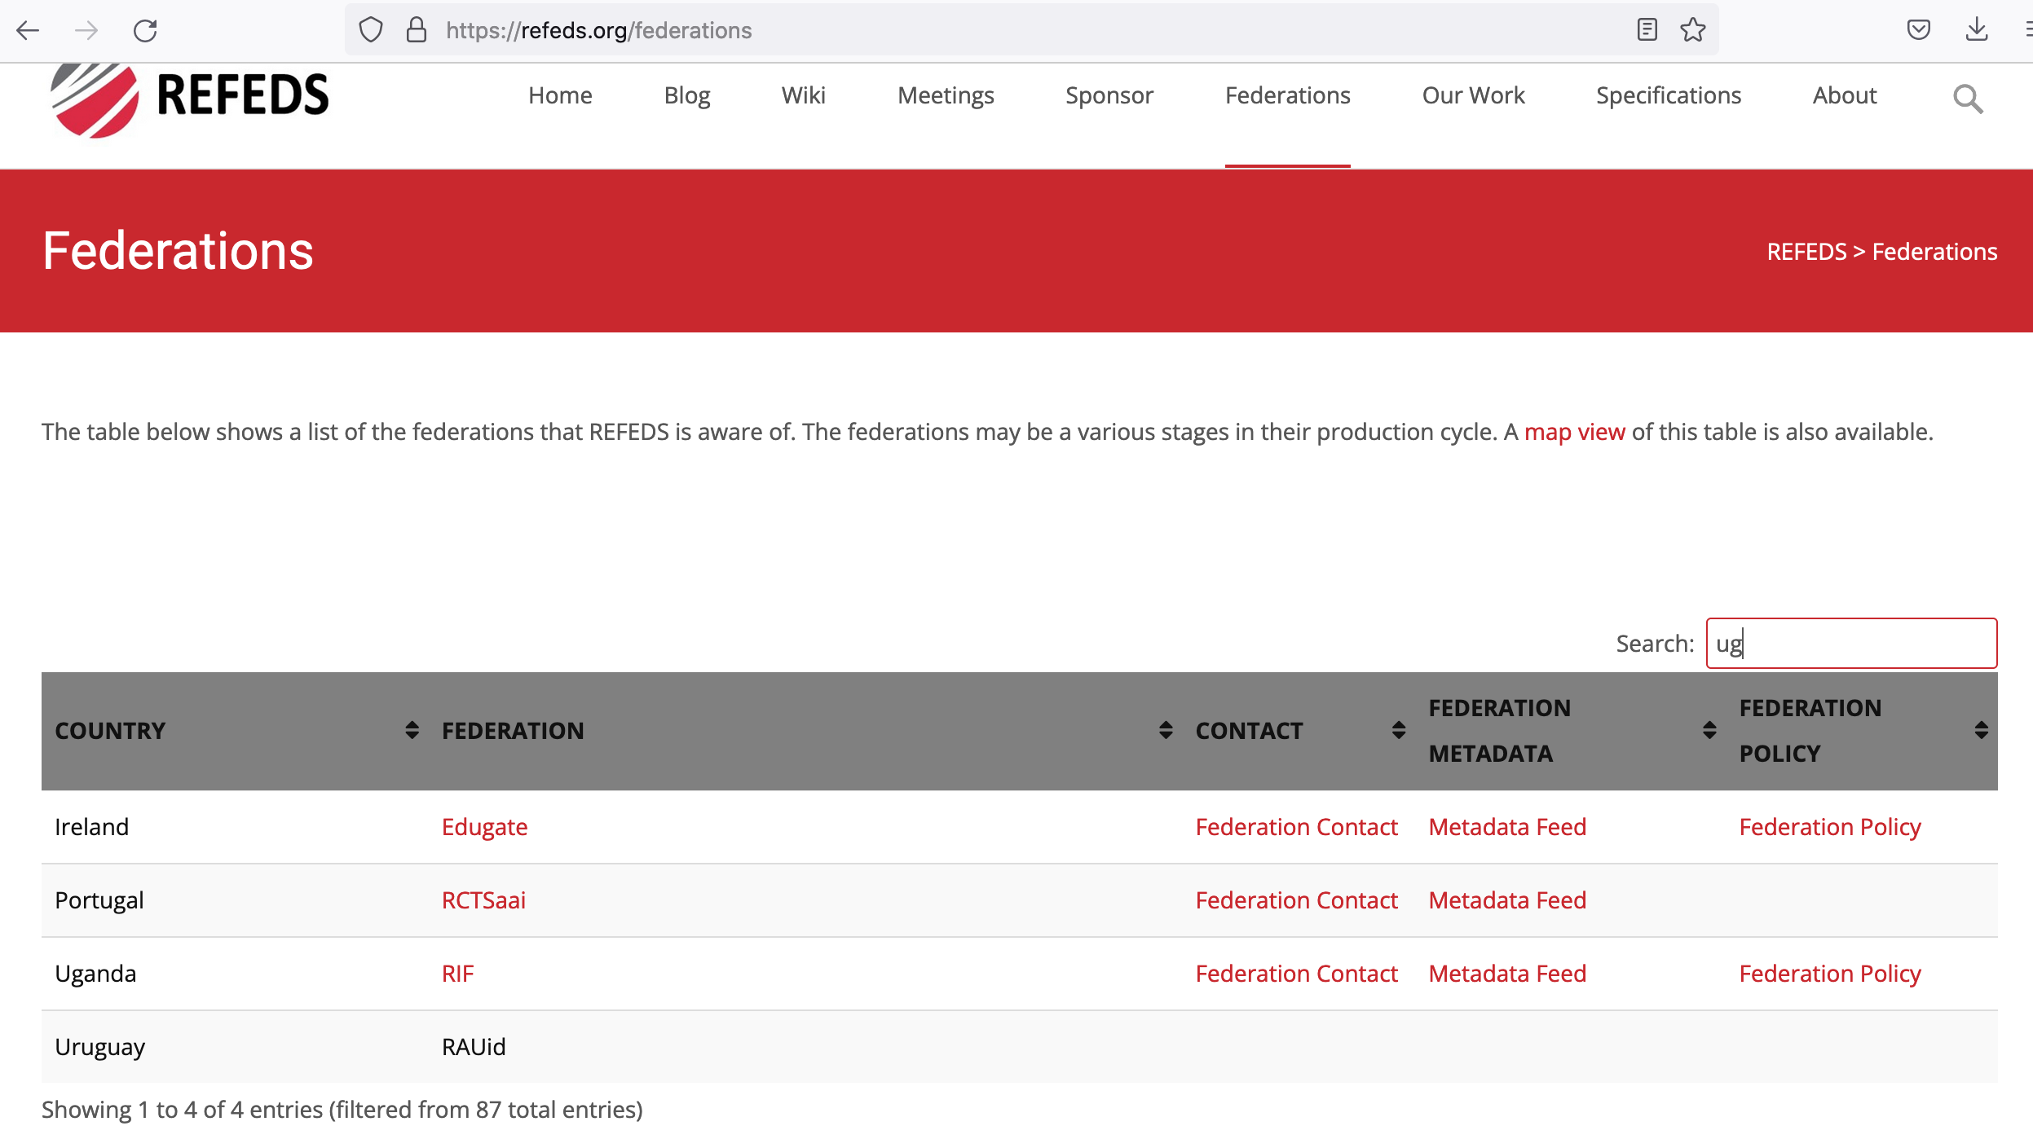

Slide 16
IdP Marathon - Agenda
Quick introduction to SAML and Federation principles
Hands-on IdP (later)

Slide 17
SAML & Federation quick tour
SAML ? Federation ?
types of entities
notion of trust
workflow federated
point-to-point vs federation
IdP useful information
Certificates
Useful attributes
Useful information for the marathon

Slide 18
Authentication management evolution
Local authentication
Centralized authentication
Federation
1 user database /app
1 user account /app
Common user database (LDAP, AD...)
1 user => 1 identity inside the organism
Access limited to local applications
Common user database (LDAP, AD...) - in the organisation
1 user => 1 identity inside the organisation
Access to application inside AND outside the organisation

Slide 19
SAML Entities
Service Provider (SP)
The application that one want to access
Identity Provider (IdP)
The server to which the SP delegates the authentication
Upon successful authentication, the IdP provides information about the user (attributes)
Exchanges are signed and eventually ciphered
Each entity is described through the means of metadata

Slide 20
Attributes exchange
urn:oid:0.9.2342.19200300.100.1.3
mail
mail
LDAP
IdP
SP
Application
SAML2
Attribute « mail »
Value : john.doe@univ.ac.cy
IdP allows or doesn’t the release
of the attribute to the SP

Slide 21
What’s inside metadata?
Main information:
entity ID (unique ID)
Certificates for signing and ciphering
Supported protocols (SAML1, SAML2)
Endpoints for login workflow
Required attributes (only for SP)
Contact email address (should be generic)

Slide 22
All is based on trust!
IdP must TRUST the SP
SP must TRUST the IdP
Trust happens when SP and IdP exchange their metadata
What if no trust?
An application could be accessed by any IdP
An SP could be used for phishing to get information about users (valid email, id, telephone…)

Slide 23
Point-2-Point vs Federation
Point-to-point trust and login flow
IdP
SP
trusted
trusted

Slide 24
Point-2-Point vs Federation
Univ. X
Education-Research Federation
CNRS
SP
IdP
SP
IdP
SP
Université Y
Université Zß
IdP
SP
IdP
SP
SP
SP
eduGAIN
Federation InCommon (USA)
Univ. Y
MIT
SP
IdP
Univ. Chicago
SP
SP
IdP
SP
IdP
SP

Slide 25
Federated authentication demo
Need for something to discover the IdP => Discovery Service / WAYF (Where Are You From)
Demo : https://rendez-vous.renater.fr

Slide 26
Certificates usage in SAML
3 types of certificates are used in Shibboleth IDP – don’t swap them
TLS certificate, to enable HTTPS between browers and IdP
Just as usual
Self-signed certificate (and private key) for signing/ciphering, with long lifetime (> 10y)
Federation operator signing certificate (the metadata file published by the federation operator is signed)

Slide 27
Shibboleth IdP high-level functionning
Shibboleth Identity Provider
Input request
Request dispatcher
LDAP
Authentication engine
flow
Authentication
Attribute resolver
Resolve attr.
Attribute filter
Filter attr.
Response

Slide 28
Recommended attributes used in Federation
https://wiki.geant.org/display/eduGAIN/IDP+Attribute+Profile+and+Recommended+Attributes

Slide 29
Marathon overview
https://geanttraining.cynet.ac.cy/sp-garr
Training SP
trusts
WAYF/DS
YOU
trusts
Training Federation
generates
IdP Shibboleth
Metadata
Your LDAP

Slide 30
Useful information for deployment
SP URL : https://sp-instxx.fim.renu.ac.ug/
Training Metadata :
URL :
Public Key :
HOW-TO :
https://github.com/ConsortiumGARR/idem-tutorials

Slide 31
For CENTOS : https://github.com/ConsortiumGARR/idem-tutorials/blob/master/idem-fedops/HOWTO-Shibboleth/Identity%20Provider/CentOS/HOWTO%20Install%20and%20Configure%20a%20Shibboleth%20IdP%20v3.4.x%20on%20CentOS%207%20with%20Apache2%20%2B%20Jetty9.md
For DEBIAN : https://github.com/ConsortiumGARR/idem-tutorials/blob/master/idem-fedops/HOWTO-Shibboleth/Identity%20Provider/Debian/HOWTO%20Install%20and%20Configure%20a%20Shibboleth%20IdP%20v3.4.x%20on%20Debian%209%20Linux%20with%20Apache2%20%2B%20Jetty9.md
For Ubuntu : https://github.com/ConsortiumGARR/idem-tutorials/blob/master/idem-fedops/HOWTO-Shibboleth/Identity%20Provider/Ubuntu/HOWTO%20Install%20and%20Configure%20a%20Shibboleth%20IdP%20v3.4.3%20on%20Ubuntu%20Linux%20LTS%2018.04%20with%20Apache2%20%2B%20Jetty9.md

Slide 32
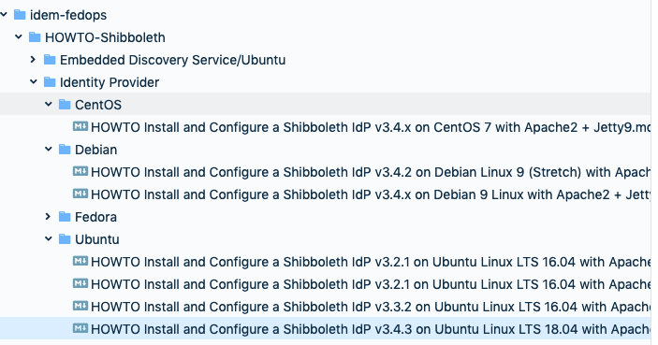
https://github.com/ConsortiumGARR

Slide 33
Places to look for support
REFEDS: Research and Education FEDrations:
https://refeds.org
MET – REFEDS: REFEDS Metadata Explore Tool
https://met.refeds.org
eduGAIN - global interfederation service:
https://edugain.org

Slide 34
Acknowledgements
NSRC https://learn.nsrc.org/fedidm
Questions/Discussion

