Slide 1
Identity Federation Technologies
RENU FIM Workshop, 4th July 2023

Slide 2
Buzzwords & acronyms
SAML
XML
Namespace
SSO
IdP
SP
NameID
eduGAIN
REFEDS
Authentication Request
Authentication Response
AuthnContextClassRef
Metadata
SIRTFI

Slide 3
SAML

Slide 4
Thar be XML...

Slide 5
XML Name Conflicts
<table>
<tr>
<td>Apples</td>
<td>Bananas</td>
</tr>
</table>
<table>
<name>African Coffee Table</name>
<width>80</width>
<length>120</length>
</table>

Slide 6
XML Name Conflicts
<h:table xmlns:h="http://www.w3.org/TR/html4/">
<h:tr>
<h:td>Apples</h:td>
<h:td>Bananas</h:td>
</h:tr>
</h:table>

Slide 7
XML Name Conflicts
<f:table xmlns:f="https://www.w3schools.com/furniture">
<f:name>African Coffee Table</f:name>
<f:width>80</f:width>
<f:length>120</f:length>
</f:table>

Slide 8
Quick Aside on XML Namespaces
<samlp:AuthnRequest xmlns:samlp="urn:oasis:names:tc:SAML:2.0:protocol">
prefix
local name
prefix
namespace URI
XML namespaces are used for providing uniquely named elements and attributes in an XML document.

Slide 9
These Two Elements Are The Same
<samlp:AuthnRequest
xmlns:samlp="urn:oasis:names:tc:SAML:2.0:protocol">
<s:AuthnRequest
xmlns:s="urn:oasis:names:tc:SAML:2.0:protocol">

Slide 10
These Two Elements Are NOT The Same
<samlp:AuthnRequest
xmlns:samlp="urn:oasis:names:tc:SAML:2.0:protocol">
<AuthnRequest>

Slide 11
Multiple Namespaces
<md:EntityDescriptor
xmlns:md="urn:oasis:names:tc:SAML:2.0:metadata"
xmlns:ds="http://www.w3.org/2000/09/xmldsig#"
xmlns:shibmd="urn:mace:shibboleth:metadata:1.0"
xmlns:xsi="http://www.w3.org/2001/XMLSchema-instance"
xmlns:mdui="urn:oasis:names:tc:SAML:metadata:ui"
entityID="https://login.rhsp.org/idp/shibboleth">

Slide 12
Default Namespace
<EntityDescriptor
xmlns="urn:oasis:names:tc:SAML:2.0:metadata"
xmlns:ds="http://www.w3.org/2000/09/xmldsig#"
xmlns:shibmd="urn:mace:shibboleth:metadata:1.0"
xmlns:xsi="http://www.w3.org/2001/XMLSchema-instance"
xmlns:mdui="urn:oasis:names:tc:SAML:metadata:ui"
entityID="https://login.rhsp.org/idp/shibboleth">

Slide 13
Children Inherit Default Namespace
<table xmlns="https://www.w3schools.com/furniture">
<name>African Coffee Table</name>
<width>80</width>
<length>120</length>
</table>

Slide 14
Children May Inherit Default Namespace
<EntityDescriptor xmlns="urn:oasis:names:tc:SAML:2.0:metadata" xmlns:ds="http://www.w3.org/2000/09/xmldsig#"> <IDPSSODescriptor> <KeyDescriptor> <ds:KeyInfo>
</ds:KeyInfo>
</KeyDescriptor>
</IDPSSODescriptor>
</EntityDescriptor>
All elements have the same prefix except for <ds:KeyInfo>

Slide 15
Security Assertion Markup Language
Security framework and open standard defined by OASIS
series of technical documents and XML schemas
Focus on SAML web browser single sign-on profile (SAML WebSSO)
Focus still further on SAML2 Interoperability Deployment Profile V1.0
SAML2int
Designed by and for higher education and research to improve interoperability
https://kantarainitiative.github.io/SAMLprofiles/saml2int.html
Version 2 being proposed now...

Slide 16
Beer Drinker’s Guide to SAML
What Is SAML, and Why Does It Exist?
Knowledge gap in how IT organizations understand how SAML works
Many administrators and engineers are familiar with traditional network-based authentication protocols like RADIUS, LDAP and SSH, b
Reliance on SAML will increase as organizations continue to transition to cloud-based vendors and services.
SAML provides a way to authenticate users to third-party web apps (like Gmail for Business, Office 365, Salesforce, Expensify, Box, Workday, etc.

Slide 17
Notes:
Stu first navigates to a dashboard his company has configured, where he’s asked to authenticate (username + password + two-factor) and then can see all the applications he has access to.
The login process and dashboard are part of the identity provider; its main purpose is to verify Stu’s identity
Next, Stu clicks the Salesforce icon and is signed into Salesforce.

Slide 18
Behind the Scenes with SAML
In SAML lingo, what happened? Let’s start by defining some terms:
Identity Provider (IdP) - The software tool or service (often visualized by a login page and/or dashboard) that performs the authentication; checking usernames and passwords, verifying account status, invoking two-factor, etc. This was the Wristband Tent.
Service Provider (SP) - The web application where user is trying to gain access. This was the Beer Tent.
SAML Assertion - A message asserting a user’s identity and often other attributes, sent over HTTP via browser redirects. This was the wristband itself.

Slide 21
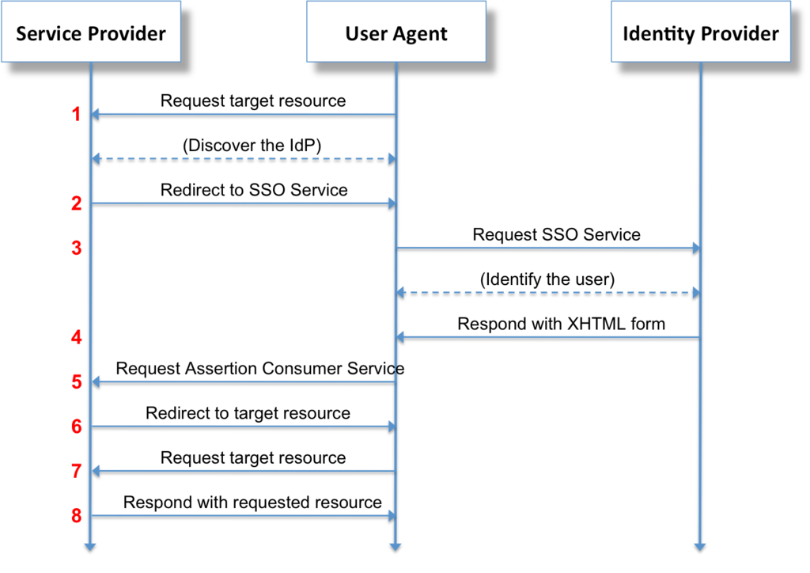
SAML Web Browser SSO: Protocol Overview

Slide 22
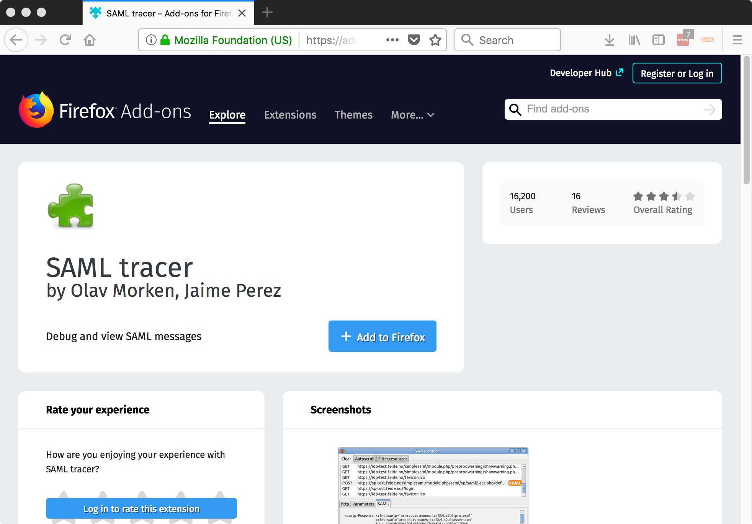

Slide 23
Trace Your SAML Web SSO Flow
SAML tracer Add-on for FireFox
SAML DevTools extension for Chrome is also available
Other tools useable but involve more work
LiveHTTPHeaders
Safari Web Inspector
Fiddler
Often combined with https://www.samltool.com/

Slide 24
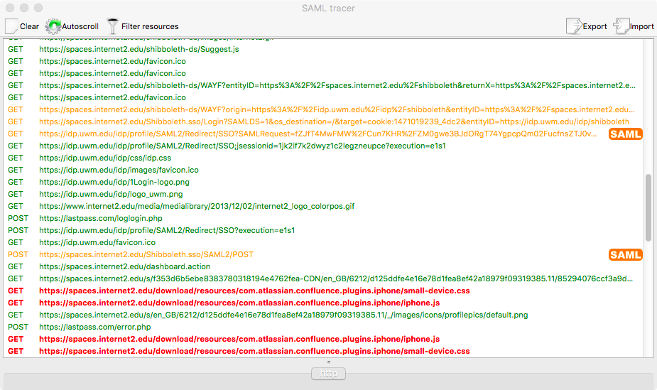

Slide 25
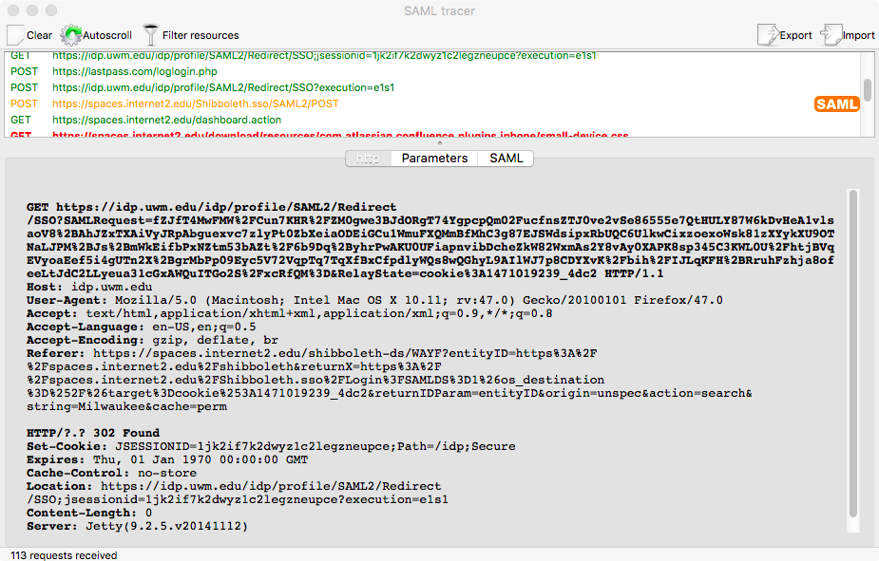

Slide 26
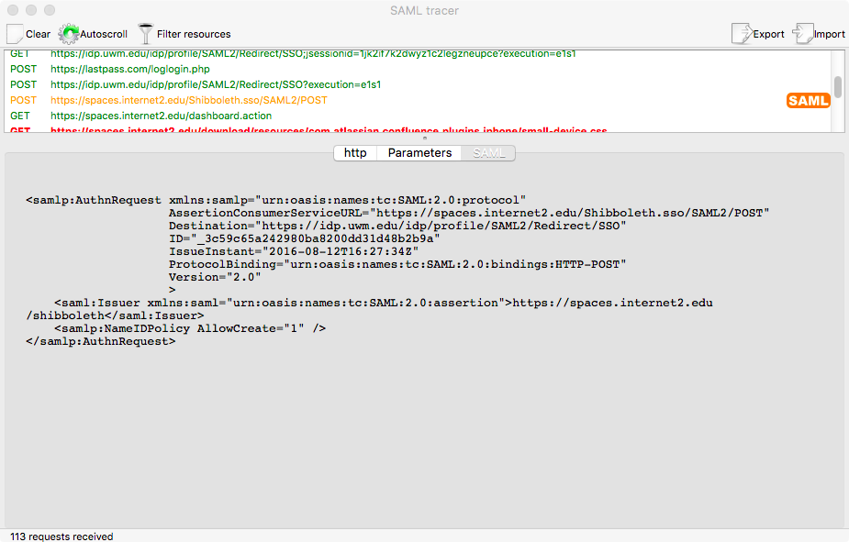

Slide 27
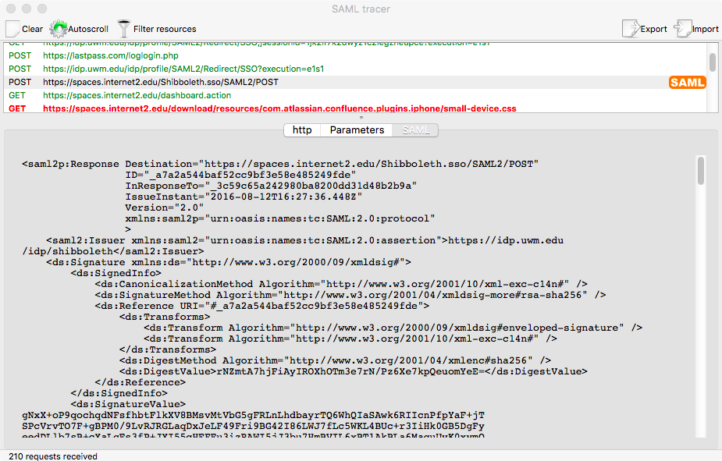

Slide 28
SAML Message Transport
Many ways to transport a SAML message (request or response)
The different ways are referred to as protocol bindings
HTTP-Redirect: SAML message passed by redirecting web browser to perform a GET from a URL with the SAML message passed in the query string
HTTP-POST: SAML message passed by delivering it to the web browser and instructing the web browser to push it using HTTP POST (like a web form)

Slide 29
SAML Message Transport
HTTP-Redirect and HTTP-POST use web browser to pass SAML message
Since web browser is the transport agent called "front channel" bindings
"Back channel" bindings also exist
Direct communication between service provider (SP) and identity provider (IdP)
HTTP Artifact binding
Much less common in higher education and research
Focus today on front channel bindings

Slide 30
SAML SP-Initiated Web SSO Flow
Most SAML SSO flows initiated at SP
SP uses the HTTP-Redirect Binding to redirect browser to the IdP
Browser does a GET to the IdP HTTP-Redirect URL endpoint
Authentication request included as query string
Base64 and URL encoded
Notes:
Describe how it links to the Beer drinkers guide as well, https://duo.com/blog/the-beer-drinkers-guide-to-saml

Slide 31
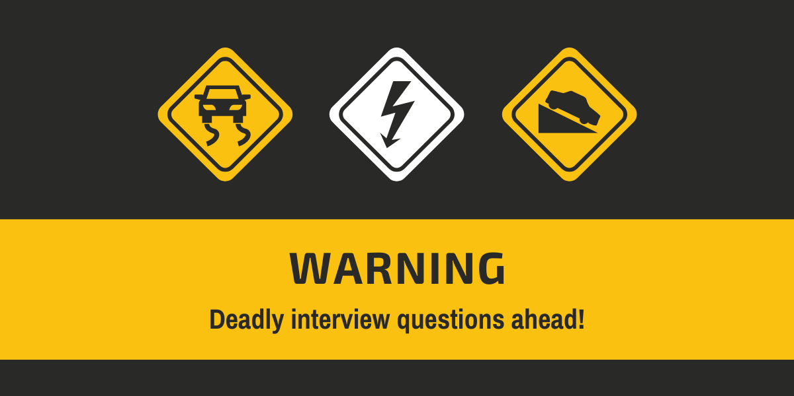
Quiz #1 Questions

Slide 32
SAML SP Initiated SSO Flow
SP may also include RelayState query parameter
Used by SP to "remember" initial resource or URL requested by browser
IdP is obligated to return the RelayState untouched

Slide 33
Redirect Binding SAMLRequest
GET https://login.rhsp.org/idp/profile/SAML2/Redirect/SSO?
SAMLRequest=jZLLbsIwEEV%2FJfKeOAmmAosgpbAoEi2IpF10UznOQCw5dupx%2Bvj7hkdbukFd%2B%2FqcmWtPUTS65Vnna7OF1w7QBx%2BNNsiPBynpnOFWoEJuRAPIveR5dr%2FiSRjx1llvpdUkyBDBeWXN3BrsGnA5uDcl4XG7SkntfYucUmkbYcQeQmxrcEoKLbXtqtCAp3mtytJq8HWIaOlBkdDNOi9IsOhnUkYc6L8sbffKXIDs%2B97Zrg17B1VVS%2FvRdkrDGbSFSjmQvSZfk2C5SMlLHLMymkgZ3UzGiZSwG7JdBYyxUTyMJyzuY4gdLA16YXxKkigeDyI2iEZFzPiI8YQ9k2BzbuBWmUqZ%2FfW6ylMI%2BV1RbAan5Z7A4XGxPkBm00Pp%2FCh2F89wHSu%2Buyez%2FzSNP01P6YXu5G75Q89fLjZWK%2FkZZFrb97kD4SElMaGz05W%2F%2F2X2BQ%3D%3D
&RelayState=ss%3Amem%3A53831b946af03f4a61a8729ecc370aa8a5e12fa9899a518371ac68f9882d9f HTTP/1.1

Slide 34
SAML SP Authentication Request
<samlp:AuthnRequest xmlns:samlp="urn:oasis:names:tc:SAML:2.0:protocol" AssertionConsumerServiceURL="https://spaces.internet2.edu/Shibboleth.sso/SAML2/POST" Destination="https://idp.ucu.ac.ug/idp/profile/SAML2/Redirect/SSO" ID="_3c59c65a242980ba8200dd31d48b2b9a" IssueInstant="2016-08-12T16:27:34Z" ProtocolBinding="urn:oasis:names:tc:SAML:2.0:bindings:HTTP-POST" Version="2.0" > <saml:Issuer xmlns:saml="urn:oasis:names:tc:SAML:2.0:assertion"> https://spaces.internet2.edu/shibboleth</saml:Issuer> <samlp:NameIDPolicy AllowCreate="1" /> </samlp:AuthnRequest>
SP Issuer SAML entityID
Every SP and IdP has unique entityID
Best practice is URL syntax
Older practice is URN

Slide 35
SAML SP Authentication Request
<samlp:AuthnRequest xmlns:samlp="urn:oasis:names:tc:SAML:2.0:protocol" AssertionConsumerServiceURL="https://spaces.internet2.edu/Shibboleth.sso/SAML2/POST" Destination="https://idp.ucu.ac.ug/idp/profile/SAML2/Redirect/SSO" ID="_3c59c65a242980ba8200dd31d48b2b9a" IssueInstant="2016-08-12T16:27:34Z" ProtocolBinding="urn:oasis:names:tc:SAML:2.0:bindings:HTTP-POST" Version="2.0" > <saml:Issuer xmlns:saml="urn:oasis:names:tc:SAML:2.0:assertion"> https://spaces.internet2.edu/shibboleth</saml:Issuer> <samlp:NameIDPolicy AllowCreate="1" /> </samlp:AuthnRequest>
Timestamp
Prevent replay attacks
Most systems tolerate some clock skew

Slide 36
SAML SP Authentication Request
<samlp:AuthnRequest xmlns:samlp="urn:oasis:names:tc:SAML:2.0:protocol" AssertionConsumerServiceURL="https://spaces.internet2.edu/Shibboleth.sso/SAML2/POST" Destination="https://idp.ucu.ac.ug/idp/profile/SAML2/Redirect/SSO" ID="_3c59c65a242980ba8200dd31d48b2b9a" IssueInstant="2016-08-12T16:27:34Z" ProtocolBinding="urn:oasis:names:tc:SAML:2.0:bindings:HTTP-POST" Version="2.0" > <saml:Issuer xmlns:saml="urn:oasis:names:tc:SAML:2.0:assertion"> https://spaces.internet2.edu/shibboleth</saml:Issuer> <samlp:NameIDPolicy AllowCreate="1" /> </samlp:AuthnRequest>
URL at the IdP that is meant to consume the request

Slide 37
SAML SP Authentication Request
<samlp:AuthnRequest xmlns:samlp="urn:oasis:names:tc:SAML:2.0:protocol" AssertionConsumerServiceURL="https://spaces.internet2.edu/Shibboleth.sso/SAML2/POST" Destination="https://idp.ucu.ac.ug/idp/profile/SAML2/Redirect/SSO" ID="_3c59c65a242980ba8200dd31d48b2b9a" IssueInstant="2016-08-12T16:27:34Z" ProtocolBinding="urn:oasis:names:tc:SAML:2.0:bindings:HTTP-POST" Version="2.0" > <saml:Issuer xmlns:saml="urn:oasis:names:tc:SAML:2.0:assertion"> https://spaces.internet2.edu/shibboleth</saml:Issuer> <samlp:NameIDPolicy AllowCreate="1" /> </samlp:AuthnRequest>
SP URL where it expects to consume the response

Slide 38
SAML SP Authentication Request
<samlp:AuthnRequest xmlns:samlp="urn:oasis:names:tc:SAML:2.0:protocol" AssertionConsumerServiceURL="https://spaces.internet2.edu/Shibboleth.sso/SAML2/POST" Destination="https://idp.ucu.ac.ug/idp/profile/SAML2/Redirect/SSO" ID="_3c59c65a242980ba8200dd31d48b2b9a" IssueInstant="2016-08-12T16:27:34Z" ProtocolBinding="urn:oasis:names:tc:SAML:2.0:bindings:HTTP-POST" Version="2.0" > <saml:Issuer xmlns:saml="urn:oasis:names:tc:SAML:2.0:assertion"> https://spaces.internet2.edu/shibboleth</saml:Issuer> <samlp:NameIDPolicy AllowCreate="1" /> </samlp:AuthnRequest>
Protocol binding the SP wants the IdP to use for sending response

Slide 39
SAML IdP Response
IdP uses HTTP-POST binding to send response to SP
Base64 encoded XML payload returned to browser
Browser does the POST
Most IdPs include Javascript to automate the POST
Turn off Javascript and you will see a button to click to force the POST

Slide 40
SAML IdP Response
Response is usually digitally signed (XML digital signature)
SP can verify and trust the response
Prevent tampering
Response payload may also be encrypted (XML encryption)
Encrypted using the SPs SAML key
Hides details from user from snooping browsers
TLS transport not usually required but usually used
Includes an assertion about the authentication event
Assertion may be encrypted if Response is not

Slide 41
<saml2p:Response Destination="https://mcap.rhsp.org/Shibboleth.sso/SAML2/POST" ID="_0e81776e9959f4478402cae0fcdb8b2e" InResponseTo="_114b09cc06982ccef34fde4445131941" IssueInstant="2018-04-05T14:54:29.730Z" Version="2.0"xmlns:saml2p="urn:oasis:names:tc:SAML:2.0:protocol">
<saml2:Issuer xmlns:saml2="urn:oasis:names:tc:SAML:2.0:assertion">https://login.rhsp.org/idp/shibboleth</saml2:Issuer>
<ds:Signature xmlns:ds="http://www.w3.org/2000/09/xmldsig#">SNIP</ds:Signature>
<saml2p:Status>
<saml2p:StatusCode Value="urn:oasis:names:tc:SAML:2.0:status:Success" />
</saml2p:Status>
<saml2:Assertion ID="_94989a68c1ffd4e373bddfd93b8328f0" IssueInstant="2018-04-05T14:54:29.730Z" Version="2.0"
xmlns:saml2="urn:oasis:names:tc:SAML:2.0:assertion">
<saml2:Issuer>https://login.rhsp.org/idp/shibboleth</saml2:Issuer>
<saml2:Subject>SNIP</saml2:Subject>
<saml2:Conditions NotBefore="2018-04-05T14:54:29.730Z" NotOnOrAfter="2018-04-05T14:59:29.730Z" >
<saml2:AudienceRestriction>
<saml2:Audience>https://mcap.rhsp.org/shibboleth</saml2:Audience>
</saml2:AudienceRestriction>
</saml2:Conditions>
<saml2:AuthnStatement AuthnInstant="2018-04-05T14:54:29.663Z" SessionIndex="_7dbbb6e0545f5c0283aff9242a95a034">
<saml2:SubjectLocality Address="136.167.36.227" />
<saml2:AuthnContext>
<saml2:AuthnContextClassRef>urn:oasis:names:tc:SAML:2.0:ac:classes:PasswordProtectedTransport</saml2:AuthnContextClassRef>
</saml2:AuthnContext>
</saml2:AuthnStatement>
<saml2:AttributeStatement>SNIP</saml2:AttributeStatement>
</saml2:Assertion>
</saml2p:Response>

Slide 42
Response
<saml2p:Response Destination="https://mcap.rhsp.org/Shibboleth.sso/SAML2/POST" ID="_0e81776e9959f4478402cae0fcdb8b2e" InResponseTo="_114b09cc06982ccef34fde4445131941" IssueInstant="2018-04-05T14:54:29.730Z" Version="2.0"xmlns:saml2p="urn:oasis:names:tc:SAML:2.0:protocol">

Slide 43
Issuer
<saml2:Issuer xmlns:saml2="urn:oasis:names:tc:SAML:2.0:assertion">
https://login.rhsp.org/idp/shibboleth
</saml2:Issuer>

Slide 44
Signature
<ds:Signature xmlns:ds="http://www.w3.org/2000/09/xmldsig#">
SNIP
</ds:Signature>

Slide 45
Status
<saml2p:Status>
<saml2p:StatusCode
Value="urn:oasis:names:tc:SAML:2.0:status:Success" />
</saml2p:Status>

Slide 46
Assertion
<saml2:Assertion ID="_94989a68c1ffd4e373bddfd93b8328f0" IssueInstant="2018-04-05T14:54:29.730Z" Version="2.0"
xmlns:saml2="urn:oasis:names:tc:SAML:2.0:assertion">
<saml2:Issuer>https://login.rhsp.org/idp/shibboleth</saml2:Issuer>
<saml2:Subject>SNIP</saml2:Subject>
<saml2:Conditions NotBefore="2018-04-05T14:54:29.730Z" NotOnOrAfter="2018-04-05T14:59:29.730Z" >
<saml2:AudienceRestriction>
<saml2:Audience>https://mcap.rhsp.org/shibboleth</saml2:Audience>
</saml2:AudienceRestriction>
</saml2:Conditions>
<saml2:AuthnStatement AuthnInstant="2018-04-05T14:54:29.663Z" SessionIndex="_7dbbb6e0545f5c0283aff9242a95a034">
<saml2:SubjectLocality Address="136.167.36.227" />
<saml2:AuthnContext>
<saml2:AuthnContextClassRef>urn:oasis:names:tc:SAML:2.0:ac:classes:PasswordProtectedTransport</saml2:AuthnContextClassRef>
</saml2:AuthnContext>
</saml2:AuthnStatement>
<saml2:AttributeStatement>SNIP</saml2:AttributeStatement>
</saml2:Assertion>

Slide 47
Issuer
<saml2:Issuer>
https://login.rhsp.org/idp/shibboleth
</saml2:Issuer>

Slide 48
Subject
<saml:Subject>
<saml:NameID
SPNameQualifier="https://chris.ws.renu.ac.ug/sp/shibboleth" Format="urn:oasis:names:tc:SAML:2.0:nameid-format:transient">
_7966a57fb03341feb7d662af18ae13e52aa2a9f375
</saml:NameID>
SNIP
</saml:Subject>

Slide 49
Subject NameID
<saml:NameID
SPNameQualifier="https://chris.ws.renu.ac.ug/sp/shibboleth" Format="urn:oasis:names:tc:SAML:2.0:nameid-format:transient">
_7966a57fb03341feb7d662af18ae13e52aa2a9f375
</saml:NameID>

Slide 50
SAML2 Subject NameID vs Subject Attributes
SAML2 spec defines a limited set of NameID formats
Not as flexible as using attributes about subject
SAML2 NameID much less used by higher education and research
Not strictly required in the SAML assertion
Most often seen with commercial vendor services or SPs
WebEx, Google Apps, Slack, box, electronic journals, ...
Due to limitations of their SAML implementations
Campus IdP administrators that federate with commercial services need to understand SAML2 NameID

Slide 51
SAML NameID Characteristics
Persistent - whether intended to be used across multiple sessions
If used for a single session only is called a transient identifier
Revocable - whether can be revoked
An identifier that persists over the entire lifetime of a subject's relationship with an IdP is called a permanent identifier
Reassignable - whether,once revoked, may be reassigned to a different subject (person)
Opaque - whether SP can identify the subject from the identifier
If so the identifier is transparent, else opaque. Email address and NetID usually transparent.

Slide 52
SAML NameID Characteristics
Targeted - whether intended for a specific SP and not for anyone else
If not targeted then shared identifier
An identifier targeted at a single SP is not shared
Portable - whether a given name identifier is usable across security domains
Global - whether a given name identifier value is globally unique
A name identifier may be "qualified" to ensure global uniqueness
Typically the qualifier is the identifier of the issuer or a DNS domain associated with the issuer

Slide 53
SAML2 NameID Format
"Transient"
Transient, opaque, global
urn:oasis:names:tc:SAML:2.0:nameid-format:transient
"Persistent"
Persistent, revocable, not reassigned, opaque, targeted, portable, not global
urn:oasis:names:tc:SAML:2.0:nameid-format:persistent
"Email"
Persistent(?), revocable, reassigned, transparent, portable, global
urn:oasis:names:tc:SAML:1.1:nameid-format:emailAddress
"Unspecified"
?
urn:oasis:names:tc:SAML:1.1:nameid-format:unspecified

Slide 54
SAML NameID
<saml2:NameID Format="urn:oasis:names:tc:SAML:2.0:nameid-format:transient"
NameQualifier="https://idp.renu.ac.ug/idp/shibboleth" SPNameQualifier="https://eduvpn.renu.ac.ug/shibboleth"> AAdzZWNyZXQxXaGECb4BuVYo5GAEL+Jaw4bprqeMjVqgXNet/fHxs/3KSZD5Wpfi1y </saml2:NameID>

Slide 55
AuthnStatement
<saml2:AuthnStatement
AuthnInstant="2018-04-05T14:54:29.663Z"
SessionIndex="_7dbbb6e0545f5c0283aff9242a95a034">
<saml2:SubjectLocality Address="136.167.36.227" />
<saml2:AuthnContext>
<saml2:AuthnContextClassRef>
urn:oasis:names:tc:SAML:2.0:ac:classes:PasswordProtectedTransport
</saml2:AuthnContextClassRef>
</saml2:AuthnContext>
</saml2:AuthnStatement>

Slide 56
AuthnContextClassRef
<saml2:AuthnContextClassRef>
urn:oasis:names:tc:SAML:2.0:ac:classes:PasswordProtectedTransport
</saml2:AuthnContextClassRef>
Notes:
An Authentication Context Class specifies a set of business rules that authentications are being requested to satisfy

Slide 57
AttributeStatement
<saml2:AttributeStatement> <saml2:Attribute FriendlyName="sn" Name="urn:oid:2.5.4.4" NameFormat=SNIP> <saml2:AttributeValue>Nsimbi</saml2:AttributeValue> </saml2:Attribute> <saml2:Attribute FriendlyName="displayName" Name="urn:oid:2.16.840.1.113730.3.1.241" NameFormat=SNIP> <saml2:AttributeValue>Ivan Frank Nsimbi</saml2:AttributeValue> </saml2:Attribute> <saml2:Attribute FriendlyName="givenName" Name="urn:oid:2.5.4.42" NameFormat=SNIP> <saml2:AttributeValue>IvanFrank</saml2:AttributeValue> </saml2:Attribute> <saml2:Attribute FriendlyName="eduPersonPrincipalName" Name="urn:oid:1.3.6.1.4.1.5923.1.1.1.6" NameFormat=SNIP> <saml2:AttributeValue>fnsimbi@rhsp.org</saml2:AttributeValue> </saml2:Attribute> <saml2:Attribute FriendlyName="mail" Name="urn:oid:0.9.2342.19200300.100.1.3" NameFormat=SNIP> <saml2:AttributeValue>fnsimbi@rhsp.org</saml2:AttributeValue> </saml2:Attribute> </saml2:AttributeStatement>

Slide 58
Attribute
<saml2:Attribute
FriendlyName="sn"
Name="urn:oid:2.5.4.4"
NameFormat="urn:oasis:names:tc:SAML:2.0:attrname-format:uri"> <saml2:AttributeValue>Nsimbi</saml2:AttributeValue> </saml2:Attribute>
Notes:
FriendlyName:, Name: This attribute represents the attribute's identifier, The URN (Uniform Resource Name) NameFormat: This attribute defines the format of the attribute's name.

Slide 59
SAML2 Attributes
Higher ed and research leverage well defined standards
eduPerson schema managed by MACE-DIR
Standard LDAP schema like sn, givenName, mail
Borrow OIDs rather than reinvent new
More later on attributes in higher ed and research federations like RENU

Slide 60
Quiz #2 Questions

Slide 61
SAML Metadata

Slide 62
Why should an IdP and SP interoperate?
Why should an IdP accept an authentication request from an SP?
Why should an IdP authenticate a user and then assert details about that event and identity information to the SP?
Why should an SP trust an assertion about a user sent to it from an IdP?

Slide 63
Trust
IdP maintains a "list" of trusted relying parties (SPs)
Only accept authentication requests from trusted SPs
Only send assertions to URLs for SPs that it trusts
Should sign/encrypt assertion/response so only the trusted SP can decrypt and consume
SP maintains a "list" of trusted relying parties (IdPs)
Only send authentication requests to trusted IdPs
Only send authentication requests to URLs for IdPs that it trusts
Only accepts signed/encrypted assertion/response from IdPs that it trusts

Slide 64
SAML Metadata Establishes Trust
XML description of the SAML entity
entityID
SAML role (IdP or SP)
URL endpoints for consuming SAML messages
signing/encryption public key material
organization information including contacts

Slide 65
<EntityDescriptor entityID="https://idp.ncsa.illinois.edu/idp/shibboleth"> <IDPSSODescriptor errorURL="https://idp.ncsa.illinois.edu/error" protocolSupportEnumeration="..."> <Extensions> <shibmd:Scope regexp="false">ncsa.illinois.edu</shibmd:Scope> <mdui:UIInfo> <mdui:DisplayName xml:lang="en">National Center for Supercomputing Applications</mdui:DisplayName> <mdui:Description xml:lang="en">National Center for Supercomputing Applications</mdui:Description> <mdui:PrivacyStatementURL xml:lang="en">...</mdui:PrivacyStatementURL> <mdui:Logo height="100" width="148" xml:lang="en">...</mdui:Logo> </mdui:UIInfo> </Extensions> <KeyDescriptor use="signing">SNIP</KeyDescriptor> <SingleSignOnService Binding="urn:oasis:names:tc:SAML:2.0:bindings:HTTP-Redirect" Location="https://idp.ncsa.illinois.edu/idp/profile/SAML2/Redirect/SSO"/> <SingleSignOnService Binding="urn:oasis:names:tc:SAML:2.0:bindings:HTTP-POST" Location="https://idp.ncsa.illinois.edu/idp/profile/SAML2/POST/SSO"/> </IDPSSODescriptor> <Organization>SNIP</Organization> <ContactPerson>SNIP</ContactPerson> </EntityDescriptor>

Slide 66
<EntityDescriptor entityID="https://cilogon.org/shibboleth"> <SPSSODescriptor protocolSupportEnumeration="urn:oasis:names:tc:SAML:2.0:protocol"> <Extensions>...</Extensions> <KeyDescriptor>SNIP</KeyDescriptor> <AssertionConsumerService
Binding="urn:oasis:names:tc:SAML:2.0:bindings:HTTP-POST"
Location="https://cilogon.org/Shibboleth.sso/SAML2/POST"/> <AttributeConsumingService index="1"> <ServiceName xml:lang="en">CILogon</ServiceName> <ServiceDescription xml:lang="en">...</ServiceDescription> <RequestedAttribute FriendlyName="displayName" Name="urn:oid:2.16.840.1.113730.3.1.241" NameFormat="urn:oasis:names:tc:SAML:2.0:attrname-format:uri"/> <RequestedAttribute FriendlyName="eduPersonPrincipalName" Name="urn:oid:1.3.6.1.4.1.5923.1.1.1.6" NameFormat="urn:oasis:names:tc:SAML:2.0:attrname-format:uri"/> <RequestedAttribute FriendlyName="mail" Name="urn:oid:0.9.2342.19200300.100.1.3" NameFormat="urn:oasis:names:tc:SAML:2.0:attrname-format:uri"/> </AttributeConsumingService> </SPSSODescriptor> <Organization>...</Organization> <ContactPerson>...</ContactPerson> </EntityDescriptor>

Slide 67
<KeyDescriptor use="signing">
<ds:KeyInfo>
<ds:X509Data>
<ds:X509Certificate>
MIIDITCCAgmgAwIBAgIJAKu+jRod+TYIMA0GCSqGSIb3DQEBBQUAMCkxJzAlBgNV
BAMTHndlYmF1dGguc2VydmljZS5vaGlvLXN0YXRlLmVkdTAeFw0xMDAyMDkyMDA3
MzdaFw0zMDAyMDQyMDA3MzdaMCkxJzAlBgNVBAMTHndlYmF1dGguc2VydmljZS5v
aGlvLXN0YXRlLmVkdTCCASIwDQYJKoZIhvcNAQEBBQADggEPADCCAQoCggEBAMpZ
P+xV7kNCuuUtg4X8MTxTnS2TSU/tompvYjI0af4q7N5od7uzEqHBD9FMvh9bZ7GS
CACX5yYjBYZCb59i0tstfpCsDBho2Wi497EjmaTw81EQ1AjM6EhRb/we0MLj0er8
8q+vnVC7Jb7DoStoNIEFoOTv8LvKldrrXVX3yHZR3bEVtvblZbGMSYtPdH/TYMDQ
cmqkpzldfz9rQFDLSM8mqBqf56zmB8uzkZKhujTXOzb4STvaq7hhAnDwT3z9c00O
XbDBWxd1CplgHwZvrbWxYxf5gTCaPvHuLY5WeA8Ky5SUZifO/szEDvEm8K0rHStK
H/blQiX5fUQ6t3SfxbsCAwEAAaNMMEowKQYDVR0RBCIwIIIed2ViYXV0aC5zZXJ2
aWNlLm9oaW8tc3RhdGUuZWR1MB0GA1UdDgQWBBR70C49vjOa/Ikk86hkX998wqQt
UDANBgkqhkiG9w0BAQUFAAOCAQEAlgMMaTIwrly4U896lUa92iif3bLGADPjc0Is
6a6k6RytjJm/r0lbtjCWW6zs1T6L7458Ow+57fyF0Oh/iXvj65m+dvCBWXnag7hN
1yMBJQMRpSjH7dLko7y0EJ/ZrKEYQwYnBGmCILvJB/MIj2eEkq2Z47uWpvrehJfb
zsEeAbjNqw1V/AJN7E4paw8aYg8TXEXAdOvNL5h7KRQw8Ui0kCw2DeTTIXExSxZd
bqw6ldfQD2fVYnLxDGTFqITCi1a9TidA4xCXD95F7uQaEao3O8ArZcyag62uiMtv
i24RvCRvD/vsnUhI82pV/DK+2icz6UDtiiKrFNAmIiR14TanfA==
</ds:X509Certificate>
</ds:X509Data>
</ds:KeyInfo>
</KeyDescriptor>

Slide 68
Higher Ed & Research SAML Trust Model
Explicit Key Trust Model
IdP/SP explicitly trusts the "keys" it finds in SAML metadata
Keys used for digital signing and/or encryption
Keys obtained from X.509 digital certificates
X.509 certs contain a lot of information in addition to keys
Only the keys are used! (Mostly)
So X.509 certs do NOT need to be part of a public key infrastructure
No "well known" certificate authority needs to issue the certificate
Self-signed X.509 digital certificates preferred for higher ed & research SAML

Slide 69
SAML Federations
Notes:
Jim Basney

Slide 70
The Role of Federations
Enable us to scale up to 1000s of IdPs and SPs
Publish digitally signed SAML metadata containing public keys, endpoint URLs, and other info about IdPs and SPs
Set standards for SAML attributes, levels of assurance, etc.
Provide support and training

Slide 71
RENU Identity Federation

Slide 72
Federation SAML Metadata
RENU Identity Federation (RIF) SAML Metadata available at https://rif.renu.ac.ug/rr/signedmetadata/federation/RIF/metadata.xml

Slide 73
RENU SAML Federation Trust Model
SAML metadata bootstraps the trust
Trust federation operators to only let in "good" metadata
Each entity (IdP or SP) consumes the metadata and has details for all other entities necessary for interoperability
Before consuming metadata each entity must verify it is properly signed by federation operator and still valid
TLS is not a substitute for verifying signature on metadata

Slide 74
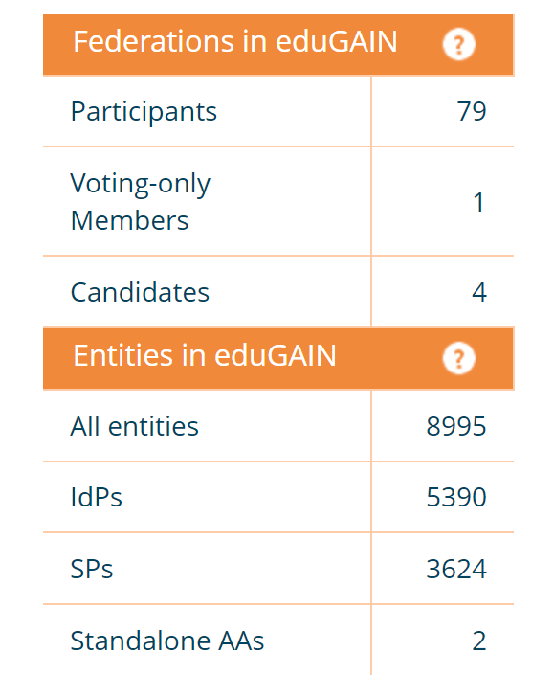
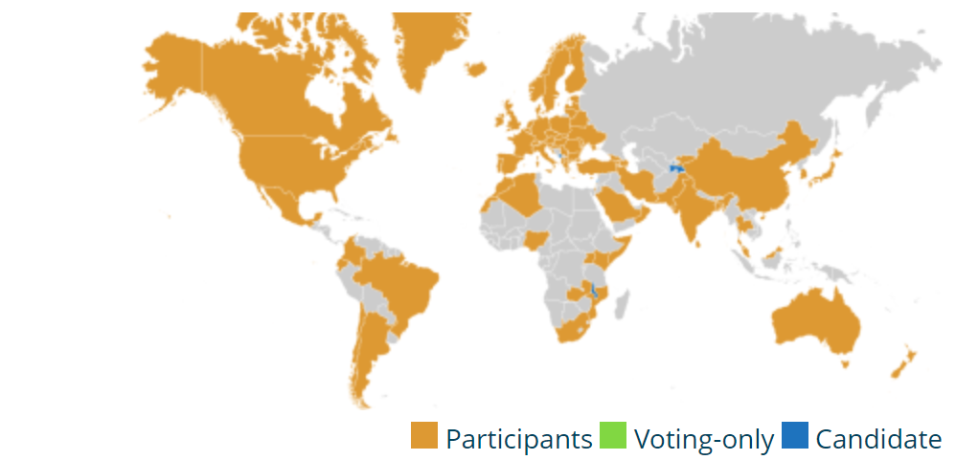
eduGAIN: Global InterFederation
RENU joined eduGAIN in 2017
Enables SAML metadata exchange across federations

Slide 75
eduGAIN: Global InterFederation
eduGAIN Policy Framework requires:
Primarily serve the interests of the R&E sector
Provide a point of contact for technical issues
Provide processes for handling complaints and incidents
Have a published Metadata registration practice statement
http://www.edugain.org
https://technical.edugain.org/

Slide 76
REFEDS Research and Scholarship (R&S)
Defines an attribute bundle:
personal identifiers:
email address
person name
eduPersonPrincipalName
pseudonymous identifier: eduPersonTargetedID
affiliation: eduPersonScopedAffiliation
https://refeds.org/research-and-scholarship

Slide 77
REFEDS Research and Scholarship (R&S)
Federations tag R&S entities in metadata:
Research and Scholarship SPs
IdPs that release the attribute bundle to R&S SPs
Research and Scholarship Entity Category
https://refeds.org/category/research-and-scholarship

Slide 78
Metadata Tag for IdP R&S Support
<EntityDescriptor entityID="https://idp.ncsa.illinois.edu/idp/shibboleth"> <Extensions> <mdrpi:RegistrationInfo registrationAuthority="https://incommon.org"/> <mdattr:EntityAttributes xmlns:mdattr="urn:oasis:names:tc:SAML:metadata:attribute"> <saml:Attribute xmlns:saml="urn:oasis:names:tc:SAML:2.0:assertion" Name="http://macedir.org/entity-category-support" NameFormat="urn:oasis:names:tc:SAML:2.0:attrname-format:uri"> <saml:AttributeValue>http://refeds.org/category/research-and-scholarship</saml:AttributeValue> </saml:Attribute> </mdattr:EntityAttributes>

Slide 79
Metadata Tag for R&S SP
<EntityDescriptor entityID="https://cilogon.org/shibboleth"> <Extensions> <mdrpi:RegistrationInfo registrationAuthority="https://incommon.org"/> <mdattr:EntityAttributes xmlns:mdattr="urn:oasis:names:tc:SAML:metadata:attribute"> <saml:Attribute xmlns:saml="urn:oasis:names:tc:SAML:2.0:assertion" Name="http://macedir.org/entity-category" NameFormat="urn:oasis:names:tc:SAML:2.0:attrname-format:uri"> <saml:AttributeValue>http://refeds.org/category/research-and-scholarship</saml:AttributeValue> </saml:Attribute> </mdattr:EntityAttributes> </Extensions>

Slide 80
SIRTFI
Security Incident Response Trust Framework for Federated Identity
Enable the coordination of incident response across federated organisations
Self-asserted by the organization operating the IdP or SP
No expensive audit
https://refeds.org/sirtfi

