Slide 1


Evolution
Not of the species – but of Campus & NREN Services
Image URL: http://secularnerd.com/2014/08/natural-selection-survival-of-the-fittest/

Slide 2
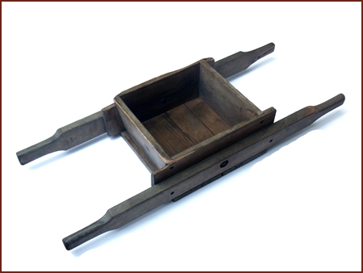
Do you know what this is?
Image URL: http://www.oldgardentools.co.uk/transporting

Slide 3
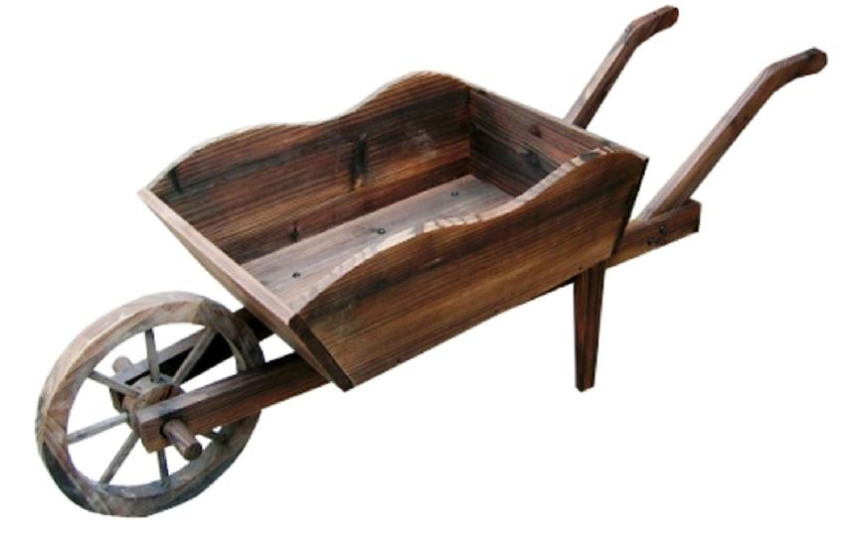
Handbarrow → Wheelbarrow
Image URL: http://pismobobs.com/2012/04/07/wooden-wheelbarrow-planter/
Notes:
Image URL: http://www.europe2you.com/product/garden.html

Slide 4
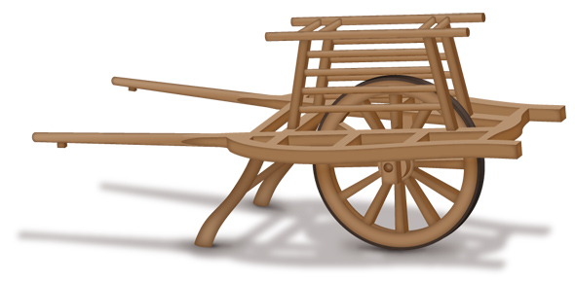
Handbarrow → Wheelbarrow
 | Handbarrow | European Wheelbarrow | Chinese Wheelbarrow
People | 2 | 1 | 1
Wheel | ✗ | ✓ | ✓
Load | ✓ | ✓ | x3
Steer + Lift | ✓ | ✓ | ✗
Image URL: http://www3.sympatico.ca/amoon/80.html
Notes:
http://www3.sympatico.ca/amoon/80.html

Slide 5

The computer lab
Image URL: http://www.fox.temple.edu/cms_about-fox/technology/it/resources/computer-labs/
Notes:
http://www.fox.temple.edu/cms_about-fox/technology/it/resources/computer-labs/

Slide 6
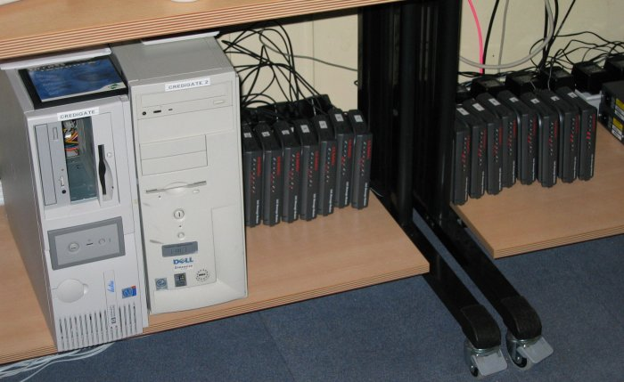
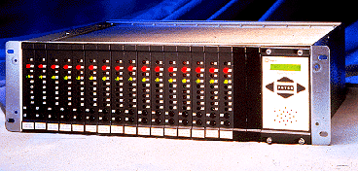
University Modem Pool
Image URL: http://www.epicycle.org.uk/weblog/2003/feb2003-2.htm Image URL: http://encyclopedia2.thefreedictionary.com/modem

Slide 7
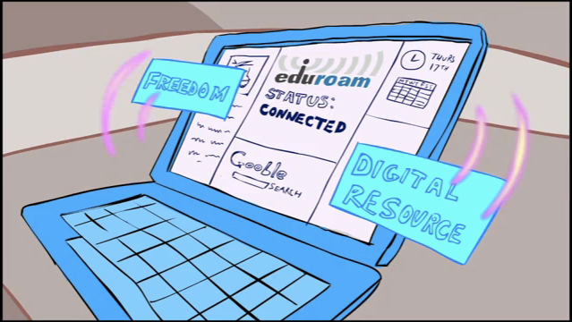
education roaming
Secure Wireless Service for Research and Education

Slide 8
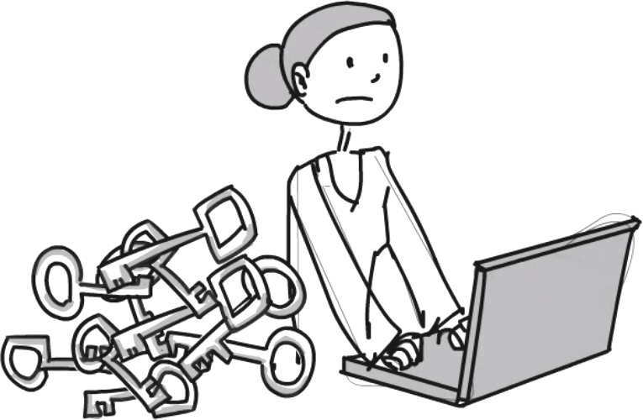

Lots of Applications
→ Lots of Passwords
One password for each application does not scale
Tons of passwords to manage for users and service operators
Varying degree of password security
Increased helpdesk/user work due to password resets
Collaborative usage of applications is difficult

Slide 9

Solution #1: LDAP
Centralised Password &
Account Storage
Re-use of Accounts/Password
across applications
Focus password security at
one location
One account for all applications
Image URL: http://www.volkanoransoy.com/

Slide 10



Solution #2: Web Single Sign-On (SSO)
Centralised Account Login
Re-use of Accounts across
applications without another
login (while your session is
valid)
No Man-in-the-Middle
password attack from LDAP
connected applications
Still limited to the campus…

Slide 11



































NREN Solution #1:
Lots of Federations…
Slide <number>
Notes:
Federations Missing: eduIDM (Morocco), Oman KID (Oman)

Slide 12
NREN Solution #2:
Global Authentication INfrastructure

Slide 13
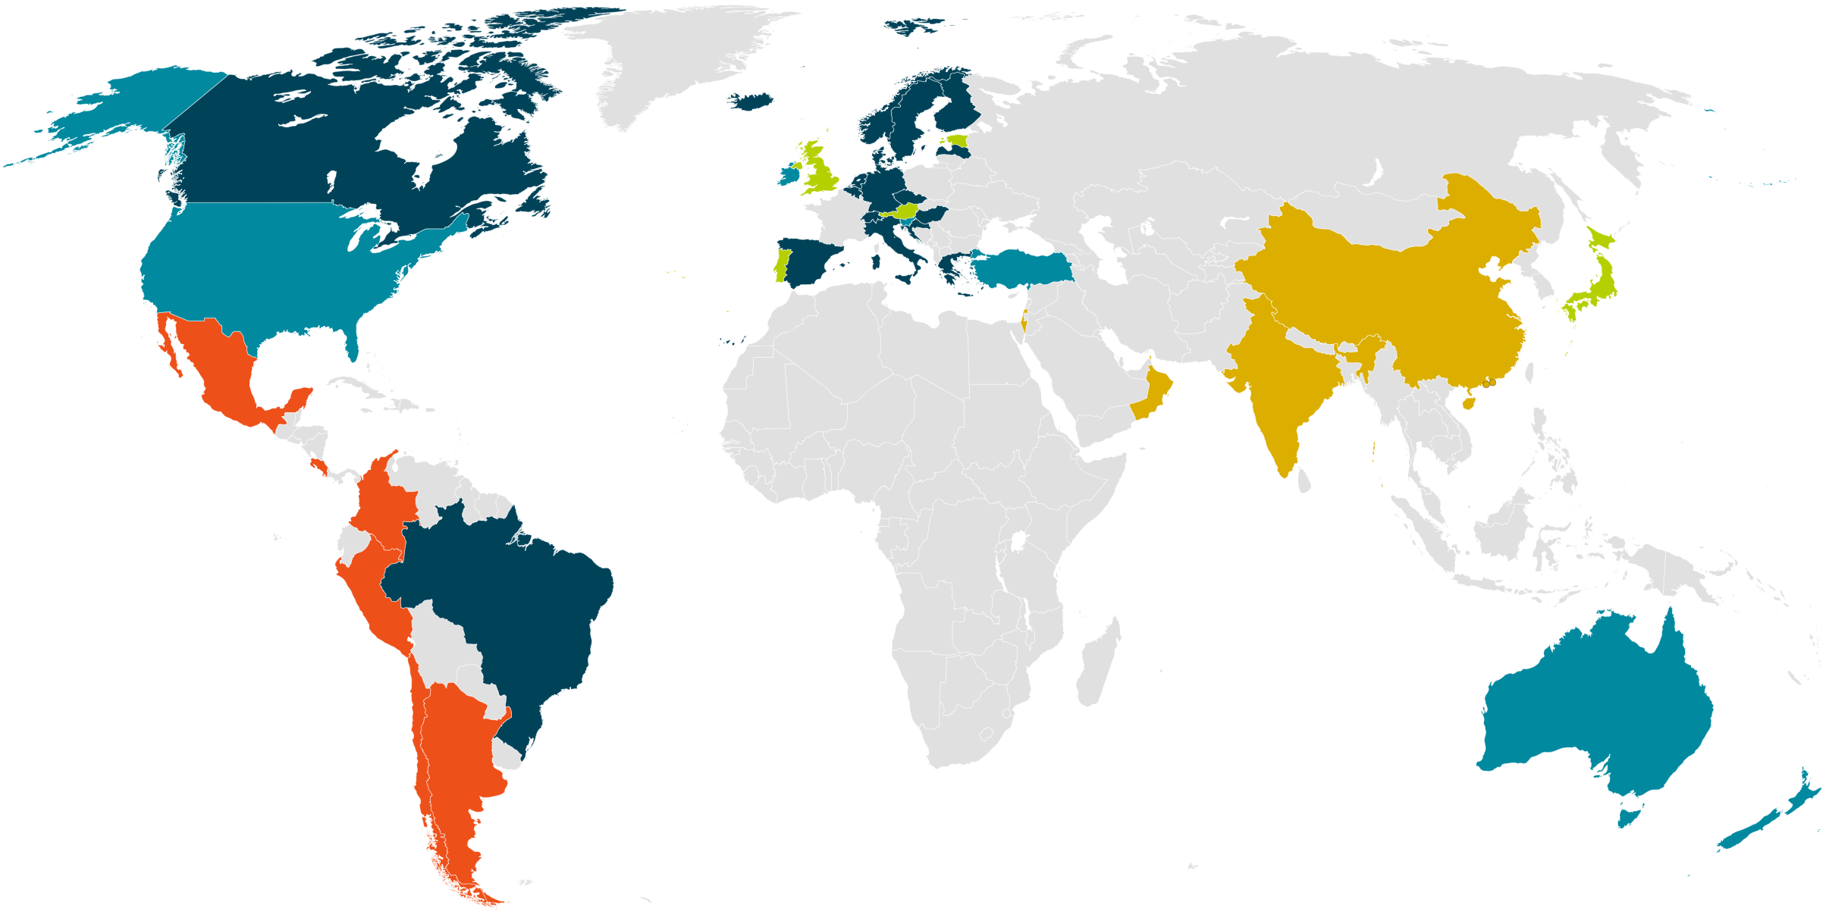
At the start of the ELCIRA project (June 2012)
eduGAIN Member
Joining eduGAIN
Candidate Federation
Existing/Pilot Federation
Target service region

Slide 14
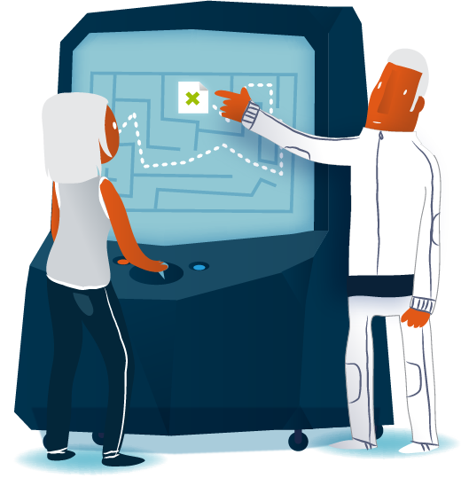
Deployment Path of NREN Services
eduroam
NREN Federation RADIUS
WebSSO
Campus IdP
SAML Federation
NREN IdP
Hotspots
Campus Services
NREN Services
eduGAIN
Federation Policy
Campus RADIUS
Sharing Services
Notes:
eduroam (FLR) -> Campus -> Hotspots
SAML Federation -> NREN IdP -> NREN SPs -> Campus IdP -> Campus SP
Federation Policy -> Join eduGAIN -> Share Services
Federation Policy -> Join eduGAIN -> Share Services
SAML Federation -> NREN IdP -> Campus IdP
eduroam -> Campus -> Hotspots

Slide 15
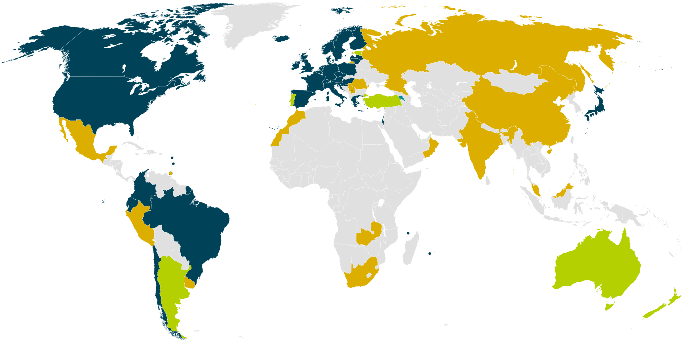
At the end of the ELCIRA project (Oct 2014)
eduGAIN Member
Joining eduGAIN
Candidate Federation
Existing/Pilot Federation
Target service region

Slide 16

Deployment Path of NREN Services
Federation Policy
Federation RADIUS
WebSSO
Campus IdP
Campus Services
SAML Federation
eduGAIN
Hotspots
Campus RADIUS
Framework to share services
eduroam
NREN IdP
NREN Services

Slide 17

How can your service evolve?
Choose your own path to evolution
  eduroam
  Campus WebSSO
  Federation & eduGAIN
Knowing there is a better way…
  …which deployment model for the future?

