Slide 1
eduroam
“Federation Light”

Slide 2
Introduction: The big eduroam picture
Role players and governance
How eduroam works
Business case for eduroam
How do we get this to work?
Common (mis)conceptions

Slide 3
Role players in eduroam

Slide 4
Identity Providers
Where you come from
Also known as an “IdP”, “home institution” or “home organisation”
Responsible for authorisation – answers the question “is this person part of your organisation?”
Operate a RADIUS† server
† Remote Access Dial-In User Service, used for network authentication

Slide 5
Service Providers
Where you are visiting
Also known as an “SP” or “visited institution”
Responsible for providing the service – maintains a network and provides Internet access
Usually operates a wireless network carrying the “eduroam” SSID‡
‡ Service Set Identifier = wireless network name

Slide 6
National Roaming Operators
Coordinate eduroam within their country or territory
Own the trademark for eduroam® in their service area
Define national policy
Responsible for ensuring compliance with global policy
Operate a RADIUS proxy
Generally one RO per country (NRO), but there are exceptions to this

Slide 7
Global eduroam Governance Committee
GeGC is responsible for the overall technical standards for eduroam
Also indirectly for the top level RADIUS proxies
Has three representatives from the African region:
Guy Halse, (TENET, South Africa)
Kennedy Aseda (KENET, Kenya)
Emmanuel Togo(GARNET, Ghana)
Notes:
https://eduroam.org/about/

Slide 8
eduroam governance model

Slide 9
eduroam governance model
eduroam relies on a tripartite trust relationship between an IdP, an SP, and the various ROs
IdPs advertise the eduroam service to their users and trust that SPs will provide it
SPs trust that the users asserted by an IdP are bona fide members of that organisation
IdPs and SPs trust ROs to convey information

Slide 10
eduroam governance model
Trust
is built in the governance layer
eduroam policy exists at all levels to:
provide a basis for a mutual understanding of responsibilities;
make the boundaries of the trust relationship clear to all parties; and
reduce the risk that the relationship will break down as the result of inadvertent or malicious actions by a minority
http://eduroam.ac.za/policy

Slide 11
How does eduroam work

Slide 12
How does eduroam work

Slide 13
How does eduroam work

Slide 14
How does eduroam work

Slide 15
How does eduroam work

Slide 16
How does eduroam work
Home Organisation
Identity Provider
Visited Organisation
Service Provider

Slide 17
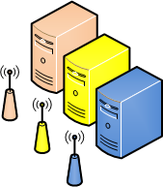
How does eduroam work
Home Organisation
Identity Provider
Roaming Operator
Visited Organisation
Service Provider

Slide 18
How does eduroam work

Slide 19
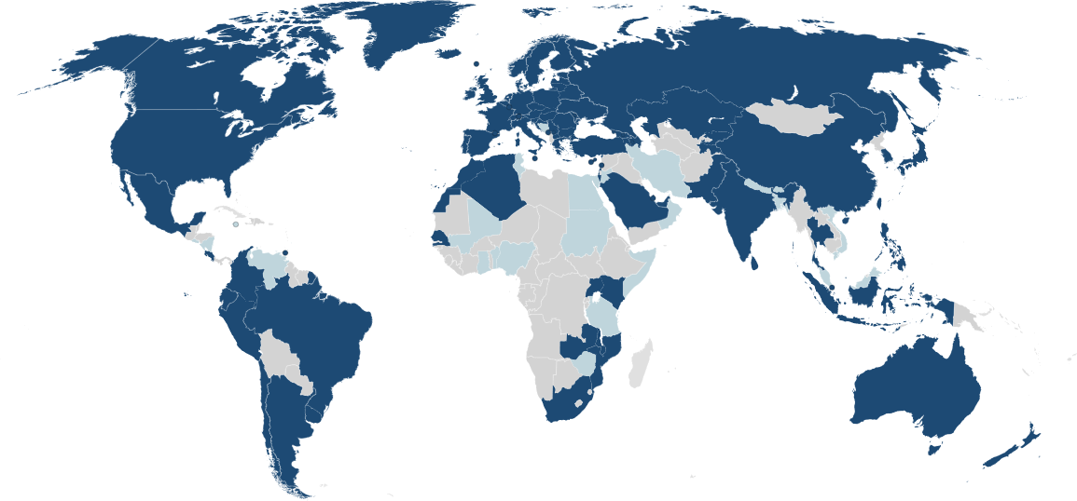
Where can we eduroam?

Slide 20
eduroam authentication model

Slide 21
eduroam authentication model
Hey, Roaming Operator, do you know anything about anonymous@example.ac.za from MyUni? They gave me this secret token.
Hi. I’m anonymous@example.ac.za from MyUni. Here’s my secret token.
Hi MyUni. Someone called anonymous@example.ac.za is claiming to be one of your users and is asking for access. They gave us this secret token. Do you know them?
OK! I know that person. Please let them have access.
OK! The Roaming Operator says MyUni knows you, you can have access.
OK! MyUni knows that person, please let them have access.
That secret token belongs to Bob. Let me check the password.
Thanks!
eduroam is great!
Is this Bob’s correct password?
Hmm. I don’t know anything about MyUni, I’ll have to ask someone.
I know about MyUni, let me ask them…
Yes, that’s correct

Slide 22
eduroam authentication model
Hey, Roaming Operator, do you know anything about anonymous@example.ac.za from MyUni? They gave me this secret token.
Hi. I’m anonymous@example.ac.za from MyUni. Here’s my secret token.
Hi MyUni. Someone called anonymous@example.ac.za is claiming to be one of your users and is asking for access. They gave us this secret token. Do you know them?
OK! I know that person. Please let them have access.
OK! The Roaming Operator says MyUni knows you, you can have access.
OK! MyUni knows that person, please let them have access.
That secret token belongs to Bob. Let me check the password.
Thanks!
eduroam is great!
Is this Bob’s correct password?
Hmm. I don’t know anything about MyUni, I’ll have to ask someone.
I know about MyUni, let me ask them…
Yes, that’s correct

Slide 23
Business case for eduroam

Slide 24
Business case for eduroam
Modest implementation & maintenance costs
Making it easier to get access to the Internet promotes co-operations and collaborative research
It also makes students less dependent on geography
Users expect access to the Internet to just work™

Slide 25
Business case for an Identity Provider
Allows your staff and students to gain access the Internet for free all over the world
Improves their productivity; makes them happy
Gives you the peace of mind that its probably more secure than a public hot-spot
Relatively straight-forward and low risk
If it doesn’t work, only your staff and students know

Slide 26
Business case for a Service Provider
Makes it easier for visitors to use your network
good for your reputation; good for their productivity
makes your campus more attractive for academic events
In most cases, leverages off your existing wireless infrastructure
Cost savings by reducing:
the amount of support your help desk does for visitors
the number of temporary visitor accounts you create
One South African university saw a 25% decrease in the first year

Slide 27
How do we get this to work?

Slide 28
eduroam Identity Provider
If you run Active Directory, you already have all you need – just configuration.
You need a source of identity
ActiveDirectory
FreeIPA
OpenLDAP
Etc
You need a RADIUS server
Windows Network Policy Server (NPS)
FreeRADIUS
Clearpass
etc
You need your NRO to route your realm

Slide 29
eduroam Service Provider
If you run an enterprise WiFi network, you already have all you need – just configuration.
You need a WiFi network
WPA2 Enterprise
CCMP / AES
You need a RADIUS proxy
Windows Network Policy Server (NPS)
FreeRADIUS
radsecproxy
Etc

Slide 30
Common (mis)conceptions

Slide 31
1) Eduroam = eduroam
It is “eduroam” not “Eduroam” or “EduRoam”
Why does the case matter?
Wireless networks are case sensitive – we want users to connect automatically so we all need to call our networks the same thing
Helps with trademark enforcement

Slide 32
2) eduroam = SP + IdP
Can’t set up eduroam because my institution charges for Internet access
Can’t set up an eduroam service provider because my institution charges for Internet access

Slide 33
2) eduroam = SP + IdP
Can’t set up eduroam because we don’t have a central directory of users
Can’t set up an eduroam identity provider because we don’t have a central directory of users
But may be able to set up multiple IdPs, or provide eduroam for a subset of users

Slide 34
2) eduroam = SP + IdP
It is okay for smaller institutions to just run an IdP
In bigger institutions there is an expectation of reciprocity, however:
It is okay to set up an IdP before an SP
It is also okay to set up an SP before an IdP
Even if it’s a really long time between the two
Growing the community benefits everyone

Slide 35
3) eduroam SP concerns
Don’t want to set up an eduroam SP because remote users will use all my bandwidth
Service providers control the type of access they provide
It is highly recommended that you put visitors on their own VLAN
Then you can throttle, block ports, etc provided:
You disclose what you’re doing
You meet your national policy (or GN3-12-192)

Slide 36
3) eduroam SP concerns
Don’t want to set up an eduroam SP because I want to know who’s using my network / I want users to accept my terms & conditions
eduroam policy requires sufficient logging to trace users – nobody is anonymous
You may publish terms and conditions on the web
You may not use a captive portal!

Slide 37
4) eduroam IdP concerns
Don’t want to expose my Active Directory / eDirectory / whatever to the Internet
You don’t have to expose any identity service to the Internet – only the roaming operator
If you’re still worried you can use a lightweight RADIUS proxy (e.g. radsecproxy) in DMZ

Slide 38
4) eduroam IdP concerns
Can’t use eduroam because my Active Directory was set up as institution.local instead of my DNS name
You do not need to change your domain!
You can add userPrincipalName aliases
In the worst case, RADIUS proxies (e.g. radsecproxy) can fix your realm

